Slide 1

www.dmu.ac.uk/tvis
Through-Vial Impedance Spectroscopy (TVIS)
A novel process analytical technology for
the development of pharmaceutical products and processes
PROF. GEOFF SMITH
Professor of Pharmaceutical Process Analytical Technology
Leicester School of Pharmacy
De Montfort University, Leicester, UK
Vienna, Austria
May 24 – 25, 2018

Slide 2
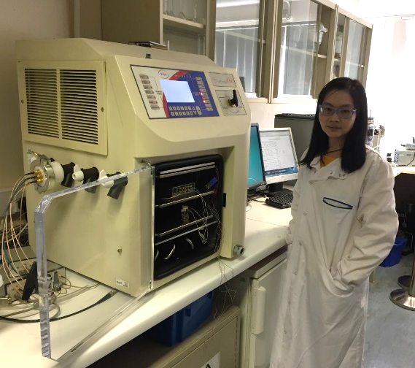
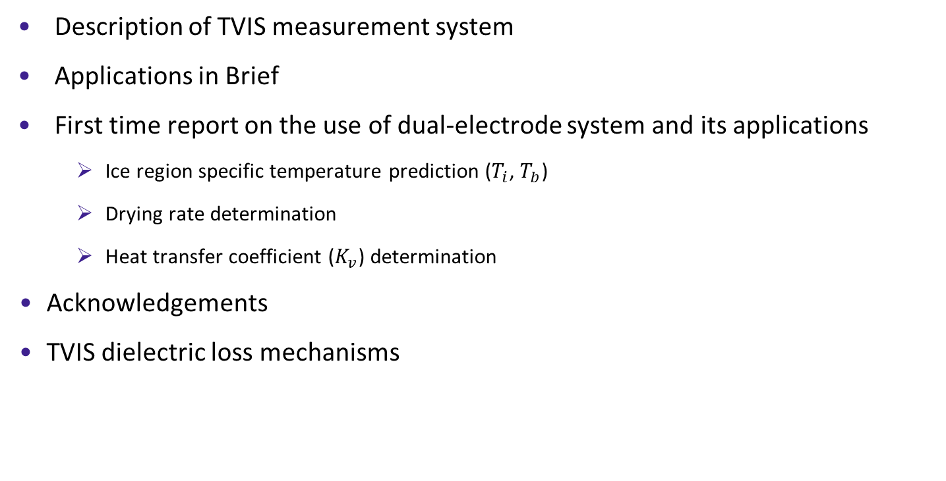
Outline
Description of TVIS measurement system
Applications in Brief
First time report on the use of dual-electrode system and its applications
    Ice region specific temperature prediction ($T_{i}$, $T_{b}$)
    Drying rate determination
    Heat transfer coefficient ($K_{v}$) determination
Acknowledgements
TVIS dielectric loss mechanisms
Notes:
Change picture for you at freeze-dryer

Slide 3
Through Vial Impedance Spectroscopy (TVIS)
Description of Measurement System

Slide 4
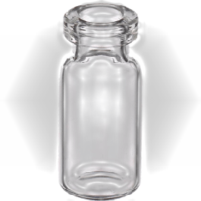
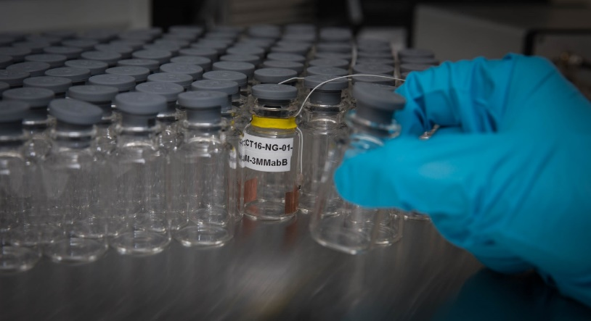
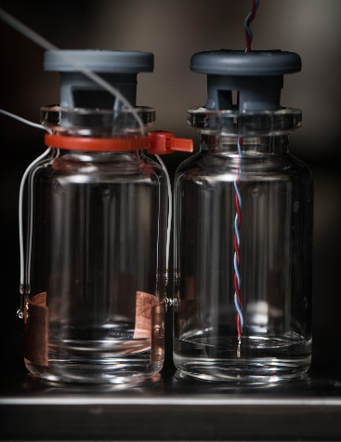
Introduction to the TVIS System
Impedance spectroscopy characterizes the ability of materials to conduct electricity under an applied an oscillating voltage (of varying frequency)
Impedance measurements across a vial rather than within the vial
Hence “Through Vial Impedance Spectroscopy”
Features
  Single vial “non-product invasive”
  Both freezing and drying characterised in a single technique
  Non-perturbing to the packing of vials
  Stopper mechanism unaffected
TVIS

Slide 5
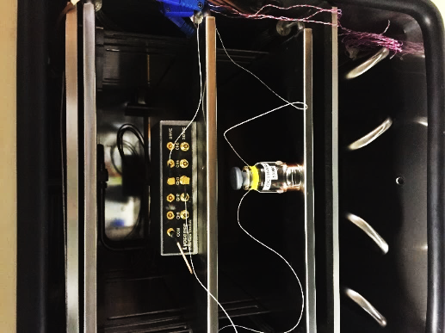
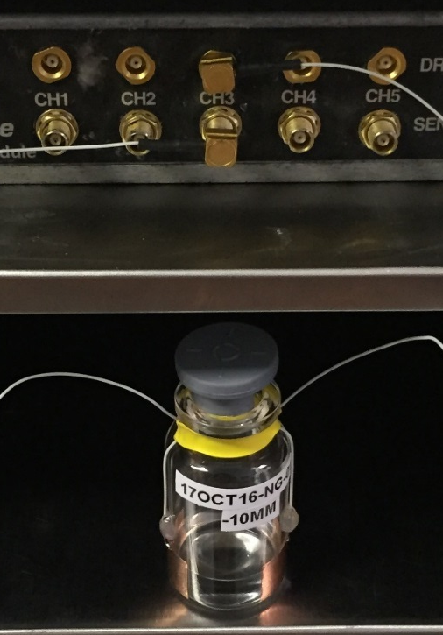
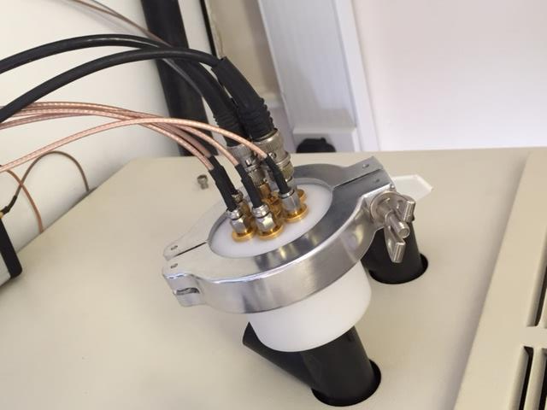
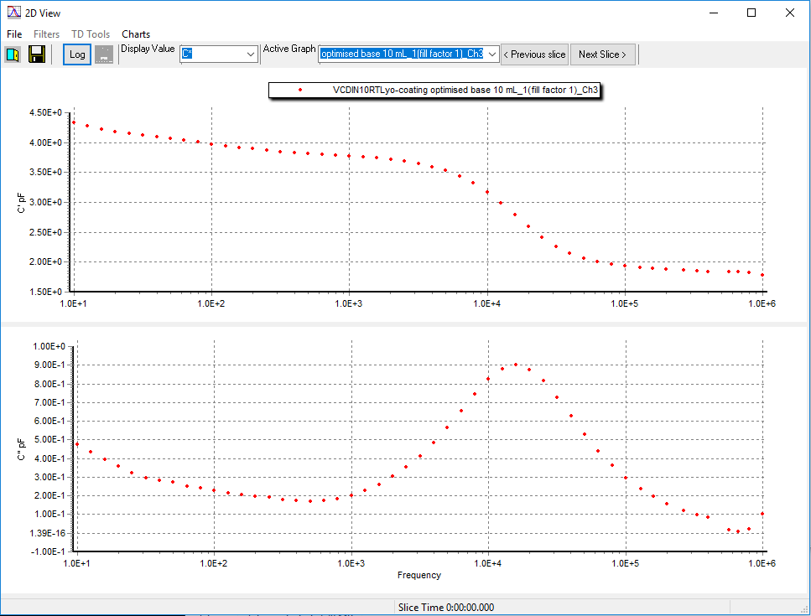
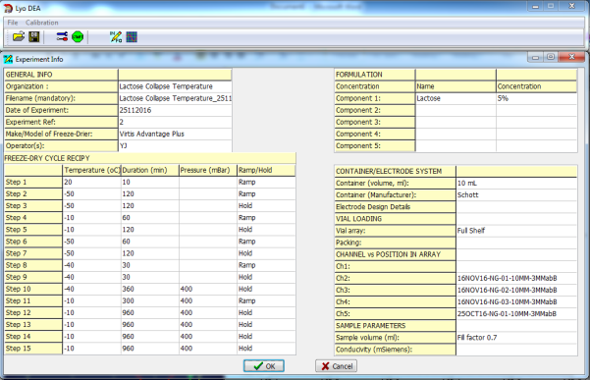
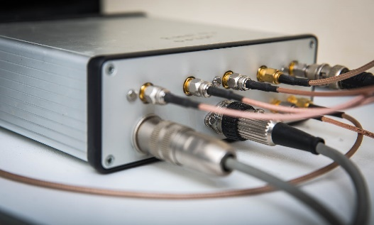
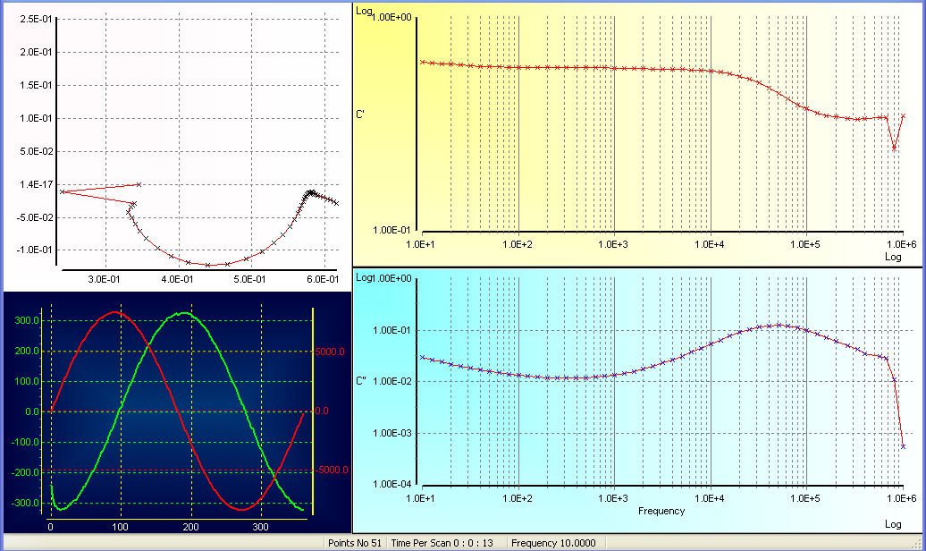
Freeze drying chamber
Junction
box
Pass-through
Resultant current
Stimulating voltage
TVIS
measurement vial
LyoViewTM analysis software
LyoDEATM measurement software
TVIS system
(I to V convertor)
Notes:
Version 14 change : don’t animate first picture – make it appear with the slide
Change photo for the pass-through to the new one
V4 edited slide

Slide 6
Through Vial Impedance Spectroscopy (TVIS)
Applications

Slide 7
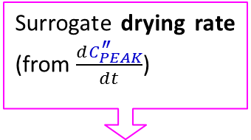
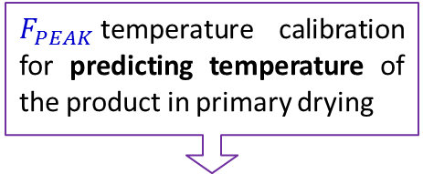
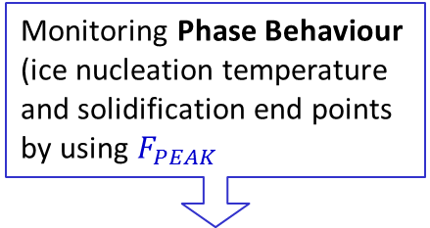
Through Vial Impedance Spectroscopy (TVIS)
Monitoring Phase Behaviour (ice nucleation temperature and solidification end points by using $F_{PEAK}$
$F_{PEAK}$temperature calibration for predicting temperature of the product in primary drying
Surrogate drying rate (from $\frac{dC_{PEAK}^{″}}{dt}$)
Liquid State
Solid State
Drying time
-18 ºC
increase
-38 ºC
F_{PEAK}
F_{PEAK}
  $C^{′}\text{(\sim 100 }\text{kHz}\text{) }$is highly sensitive to low ice volumes; therefore it could be used for determination end point of primary drying
Notes:
Eg temperature cycling below to calibrate Fpeak for temperature (in order to predict product temperatures in primary drying) and the compensate cpeak for temperature so that it can used to monitor ice content and hence drying rate
Eg 2 left graph: monitoring phase behaviour (ice nucleation temperatures and solidufication end points)

Slide 8
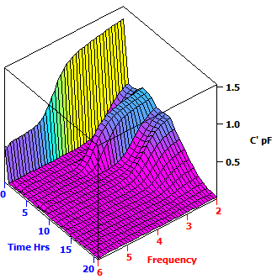
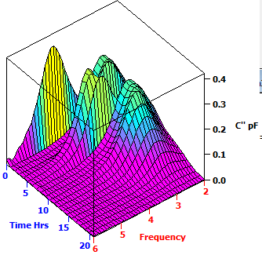
TVIS Response Surface (3D-Plot)
Imaginary Part of Capacitance
Real Part of Capacitance
Annealing = Re-heating and Re-cooling
Liquid state
Frozen solid
Liquid state
Re-heating
Re-heating
Re-cooling
Frozen solid
Re-cooling
Primary drying
Primary drying
low frequency
low frequency
Intermediate frequency
low frequency
High frequency
Notes:
Full Shelf Water Study_010716_Ch1 (Filling volume = 2 mL) touch base electrode

Slide 9



Dielectric loss spectrum
Data analysing software (LyoView ™) identifies the peak frequency ($F_{PEAK}$) and peak amplitude ($C_{PEAK}^{″}$) in the imaginary part of the capacitance spectrum
$$C_{PEAK}^{″}$$
$$F_{PEAK}$$

Slide 10
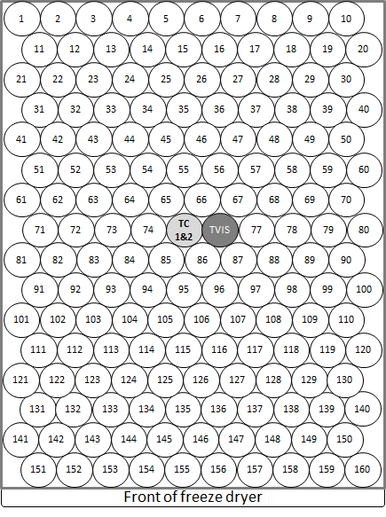
Through Vial Impedance Spectroscopy (TVIS)
Dual-electrode system and its applications
(Ice temperature, Drying rate and Heat transfer coefficient )

Slide 11
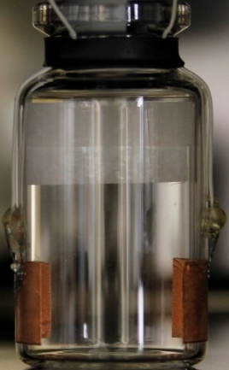


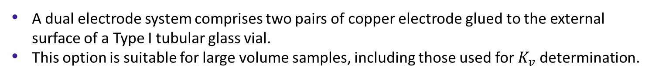
Dual-electrode system
Standard TVIS vial
(Single electrode system)
New feature of TVIS vial
(Dual electrode system)
~3.4 g of water $(∅ =0.7)$
~8 g of water $(∅ =0.7)$
Top electrode height ~15 mm
Electrode height ~10 mm
Gap between electrode ~3 mm
Bottom electrode height ~10 mm
Electrode distance from base ~3 mm
Electrode distance from base ~3 mm
Electrode Dimension
10 x 19 mm
Electrode Dimension
Top electrode (TE): 10 x 19 mm
Bottom Electrode (BE): 5 x 19 mm
A dual electrode system comprises two pairs of copper electrode glued to the external surface of a Type I tubular glass vial.
This option is suitable for large volume samples, including those used for $K_{v}$ determination.

Slide 12

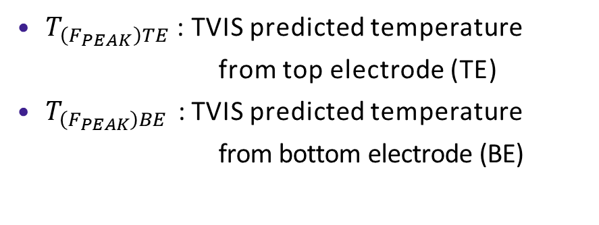

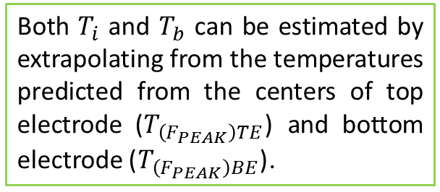


Temperature Determination
$T_{\left(F_{PEAK}\right)TE}$ : TVIS predicted temperature
from top electrode (TE)
$T_{\left(F_{PEAK}\right)BE}$ : TVIS predicted temperature
from bottom electrode (BE)
Dual electrode
15 x 19 mm
$$T_{i}$$
$$T_{\left(F_{PEAK}\right)TE}$$
Both $T_{i}$ and $T_{b}$ can be estimated by extrapolating from the temperatures predicted from the centers of top electrode ($T_{\left(F_{PEAK}\right)TE}$) and bottom electrode ($T_{\left(F_{PEAK}\right)BE}$).
3 mm gap
5 x 19 mm
$$T_{\left(F_{PEAK}\right)BE}$$
3 mm gap
$$T_{b}$$

Slide 13
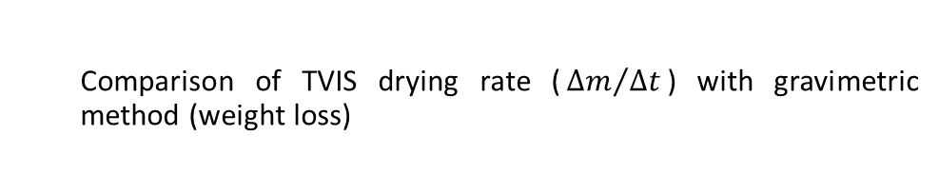
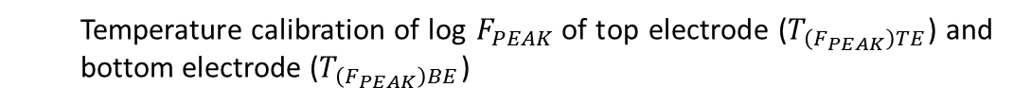
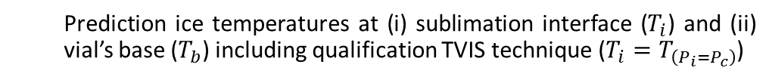
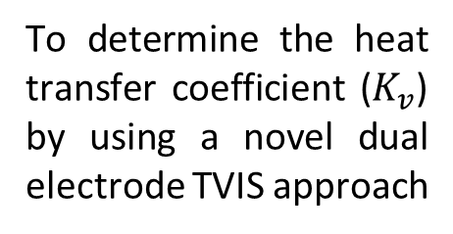
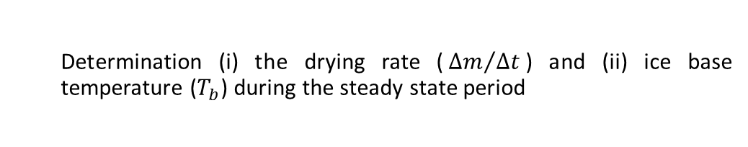
Aims & Objectives
Temperature calibration of log $F_{PEAK}$of top electrode ($T_{\left(F_{PEAK}\right)TE}$) and bottom electrode ($T_{\left(F_{PEAK}\right)BE}$)
I
Prediction ice temperatures for both electrodes during primary drying
II
Temperature calibration of $C_{PEAK}^{″}$
III
Aims
Compensation of $C_{PEAK}^{″}$ during primary drying
IV
To determine the heat transfer coefficient ($K_{v}$) by using a novel dual electrode TVIS approach
Calibration of $C_{PEAK}^{″}$ for ice layer height
V
Estimation of ice layer height during primary drying
VI
Prediction ice temperatures at (i) sublimation interface ($T_{i}$) and (ii) vial’s base ($T_{b}$) including qualification TVIS technique ($T_{i}=T_{\left(P_{i}=P_{c}\right)}$)
VII
Comparison of TVIS drying rate (${∆m}/{∆t}$) with gravimetric method (weight loss)
VIII
Determination (i) the drying rate (${∆m}/{∆t}$) and (ii) ice base temperature ($T_{b}$) during the steady state period
IX
Heat transfer coefficient ($K_{v})$ calculation
X

Slide 14
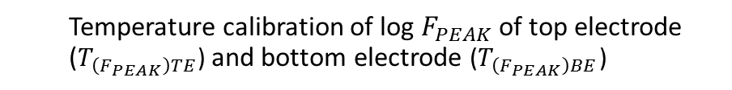
Objective
Temperature calibration of log $F_{PEAK}$of top electrode ($T_{\left(F_{PEAK}\right)TE}$) and bottom electrode ($T_{\left(F_{PEAK}\right)BE}$)
I
Annealing the sample
In-line TVIS measurement
Identifying peak frequency ($F_{PEAK}$) using LyoView ™ software
Identifying peak frequency (𝐹_𝑃𝐸𝐴𝐾) using LyoView ™ software
Predicting product temperature using calibration plot
Calibration plot (temperature vs Log $F_{PEAK}$)
Calibration plot (temperature vs Log 𝐹_𝑃𝐸𝐴𝐾)

Slide 15
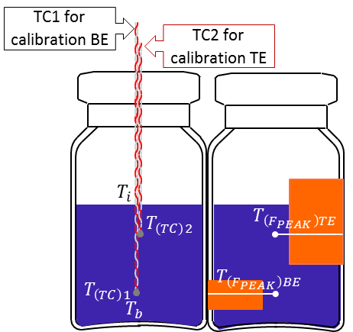
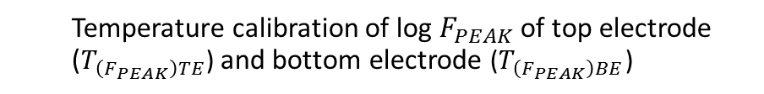


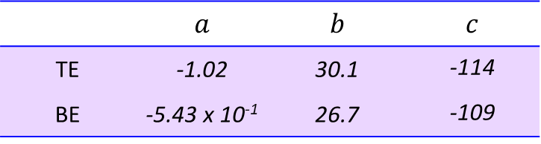
Objective
Temperature calibration of log $F_{PEAK}$of top electrode ($T_{\left(F_{PEAK}\right)TE}$) and bottom electrode ($T_{\left(F_{PEAK}\right)BE}$)
I
Top electrode
-25 °C
Shelf Temp.
$$T_{\left(TC\right)1}$$
$$T_{\left(TC\right)2}$$
Bottom electrode
Polynomial coefficient from $Log F_{PEAK}−temperature$calibration
 | $$a$$ | $$b$$ | $$c$$
TE | -1.02 | 30.1 | -114
BE | -5.43 x 10⁻¹ | 26.7 | -109
Top electrode

Slide 16
Objective
Prediction ice temperatures for both electrodes during primary drying
II

Slide 17










Objective
Prediction ice temperatures for both electrodes during primary drying
II
Temp. constant
Temp. constant
Shelf Temperature ${(T}_{s})$
$$T_{\left(TC\right)1}$$
$$T_{\left(F_{PEAK}\right)BE}$$
$$T_{\left(TC\right)2}$$
$$T_{\left(F_{PEAK}\right)TE}$$
$$T_{\left(TC\right)2}$$
$$T_{(P_{i}=P_{C@270μbar})}=−33.2 ℃$$
$$T_{\left(TC\right)1}$$
$$T_{\left(F_{PEAK}\right)BE}$$
$$T_{\left(F_{PEAK}\right)TE}$$
The product temperature predicted by TVIS can demonstrate the temperature gradient across ice cylinder height

Slide 18

Objective
Temperature calibration of $C_{PEAK}^{″}$
III
Annealing the sample
In-line TVIS measurement
Identifying peak amplitude ($C_{PEAK}^{″}$) using LyoView ™ software
Identifying peak amplitude (𝐶_𝑃𝐸𝐴𝐾^″) using LyoView ™ software
Temperature compensation of $C_{PEAK}^{″}$ using calibration plot
Temperature compensation of 𝐶_𝑃𝐸𝐴𝐾^″ using calibration plot
Calibration plot ($C_{PEAK}^{″}$ vs temperature)
Calibration plot (𝐶_𝑃𝐸𝐴𝐾^″ vs temperature)

Slide 19

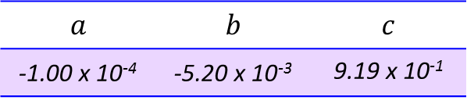
Objective
Temperature calibration of $C_{PEAK}^{″}$
III
Top electrode
-25.5 °C
Shelf Temp.
$$T_{\left(TC\right)1}$$
$$T_{\left(TC\right)2}$$
Top electrode
-40 °C
-14.5 °C
Polynomial coefficient from $C_{PEAK}^{″}−temperature$calibration
$$a$$ | $$b$$ | $$c$$
-1.00 x 10⁻⁴ | -5.20 x 10⁻³ | 9.19 x 10⁻¹

Slide 20

Objective
Compensation of $C_{PEAK}^{″}$ during primary drying
IV

Slide 21




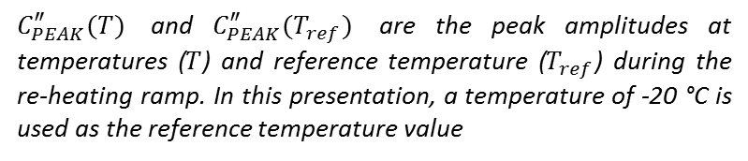




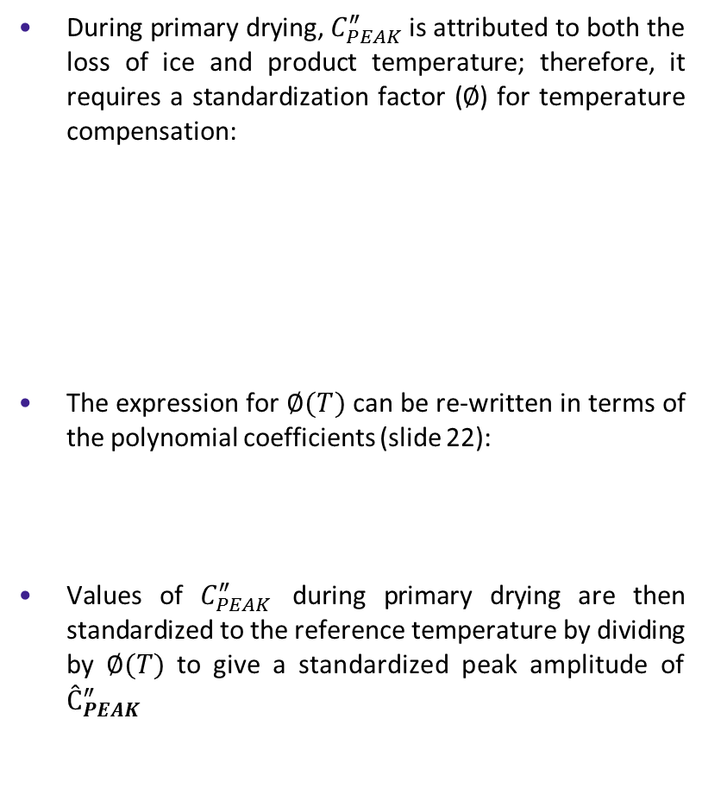

Objective
Compensation of $C_{PEAK}^{″}$ during primary drying
IV
During primary drying, $C_{PEAK}^{″}$ is attributed to both the loss of ice and product temperature; therefore, it requires a standardization factor ($∅$) for temperature compensation:
The expression for $∅(T)$ can be re-written in terms of the polynomial coefficients (slide 22):
Values of $C_{PEAK}^{″}$ during primary drying are then standardized to the reference temperature by dividing by $∅(T)$ to give a standardized peak amplitude of $Ĉ_{PEAK}^{″}$
$$T_{\left(F_{PEAK}\right)TE}$$
$$∅(T)=\frac{C_{PEAK}^{″}(T)}{C_{PEAK}^{″}(T_{ref})}$$
$C_{PEAK}^{″}(T)$ and $C_{PEAK}^{″}(T_{ref})$ are the peak amplitudes at temperatures ($T$) and reference temperature ($T_{ref}$) during the re-heating ramp. In this presentation, a temperature of -20 °C is used as the reference temperature value
$$Ĉ_{PEAK(0 h)}^{″}0.971 pF$$
$∅(T)$ $=\frac{aT^{2}+bT+c}{a{T_{ref}}^{2}+bT_{ref}+c}$
$$C_{PEAK(0)}^{″}0.931 pF$$
$$C_{PEAK(4.9 h)}^{″}0.571 pF$$
$$Ĉ_{PEAK}^{″}=\frac{C_{PEAK}^{″}(T)}{∅(T)}$$
The standardized $C_{PEAK}^{″}$ is defined as $Ĉ_{PEAK}^{″}$

Slide 22

Objective
Calibration of $C_{PEAK}^{″}$ for ice layer height
V
Filling water into TVIS vial
Freezing the sample
In-line TVIS measurement
Calibration plot ($C_{PEAK}^{″}$ vs temperature)
Calibration plot (𝐶_𝑃𝐸𝐴𝐾^″ vs temperature)
Thawing the sample
Identifying $C_{PEAK}^{″}$ using simple peak finding
Identifying 𝐶_𝑃𝐸𝐴𝐾^″ using simple peak finding

Slide 23
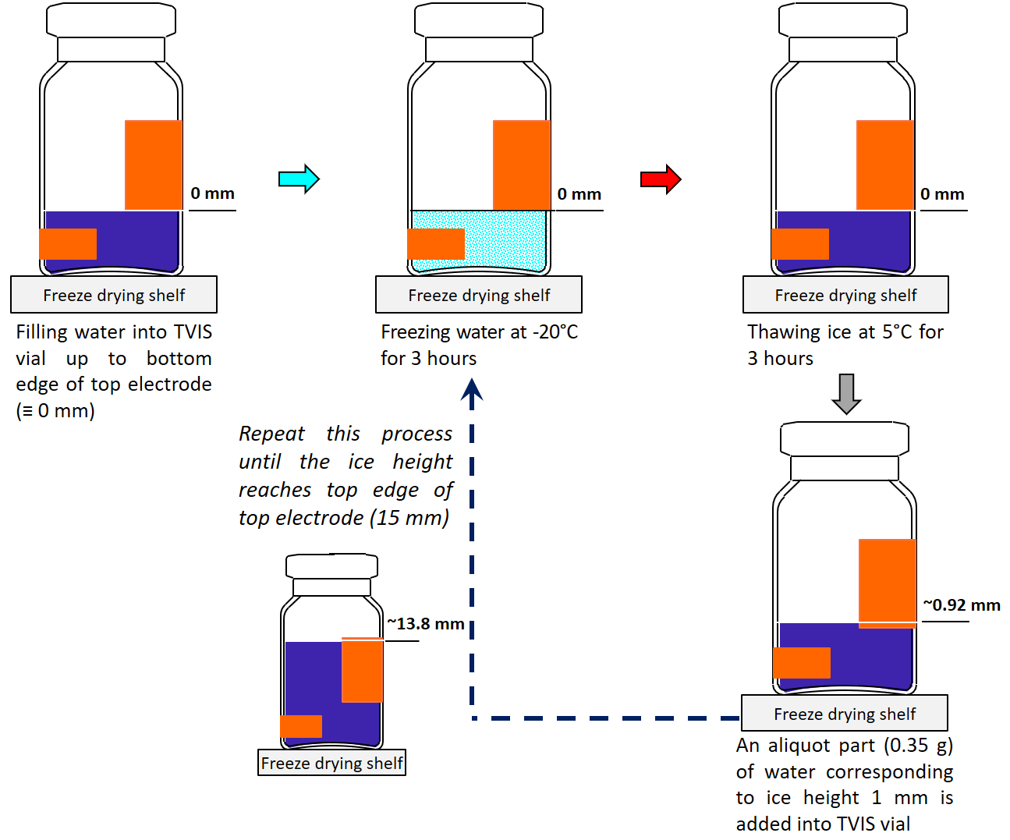
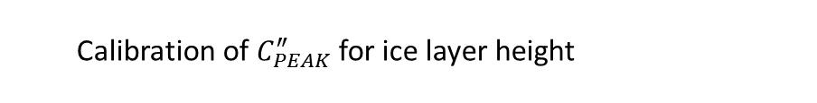
Objective
Calibration of $C_{PEAK}^{″}$ for ice layer height
V
15 mm
0 mm

Slide 24
Objective
Estimation of ice layer height during primary drying
VI

Slide 25
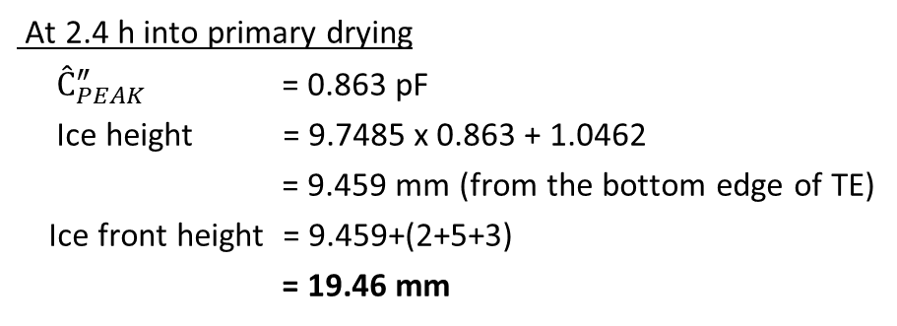



Objective
Estimation of ice layer height during primary drying
VI
At -20 °C
Top electrode (TE)
15 X 19 mm
3 mm gap
Bottom electrode (BE)
5 x 19 mm
$$Ice height(h)=9.7485×C_{PEAK}^{″}+1.0462$$
3 mm gap
Freeze Dryer Shelf
Gradient of the line ($m_{h/c}$)
At 2.4 h into primary drying
$Ĉ_{PEAK}^{″}$ = 0.863 pF
Ice height = 9.7485 x 0.863 + 1.0462
= 9.459 mm (from the bottom edge of TE)
Ice front height = 9.459+(2+5+3)
= 19.46 mm
$Ĉ_{PEAK}^{″}$ 0.863 pF
9.46 mm
19.46 mm
3 mm
5 mm
10 mm
2 mm
Freeze drying shelf

Slide 26
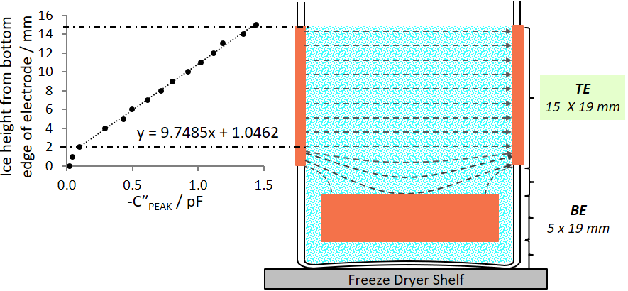


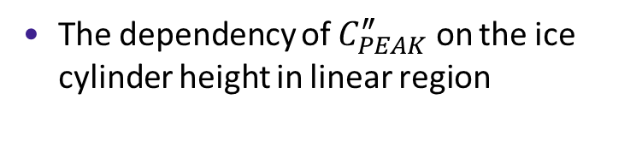




Objective
Estimation of ice layer height during primary drying
VI
The dependency of $C_{PEAK}^{″}$ on the ice cylinder height in linear region
Surrogate drying rate can be estimated in terms of decreasing ice height
$h_{(0 h)}$ 20.50 mm
$$y=9.7485x+1.0462$$
$$h_{(4.9 h)} \text{16.68} \text{mm}$$
$$C_{PEAK}^{″}$$
$${Linear gradient (m}_{h/c})$$
$$Ice height \left(h\right)$$

Slide 27
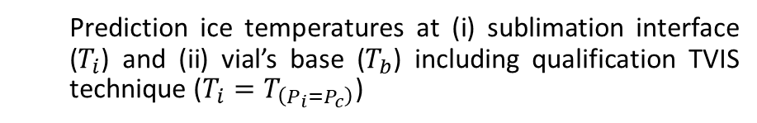
Objective
Prediction ice temperatures at (i) sublimation interface ($T_{i}$) and (ii) vial’s base ($T_{b}$) including qualification TVIS technique ($T_{i}=T_{\left(P_{i}=P_{c}\right)}$)
VII

Slide 28










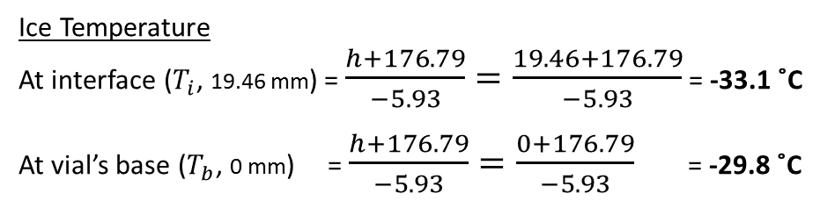
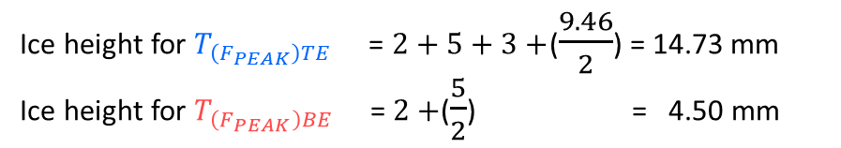

Objective
Prediction ice temperatures at (i) sublimation interface ($T_{i}$) and (ii) vial’s base ($T_{b}$) including qualification TVIS technique ($T_{i}=T_{\left(P_{i}=P_{c}\right)}$)
VII
$$T_{b}$$
At 2.4 h
$$h=−5.93×T−176.79$$
-30.6 ˚C
$$T_{\left(F_{PEAK}\right)BE}$$
$$T_{\left(F_{PEAK}\right)TE}$$
-32.3 ˚C
$T_{i}$ -33.1 ˚C
$T_{\left(F_{PEAK}\right)TE}$ -32.3 ˚C
$$T_{i}$$
19.46 mm
14.73 mm
9.46 mm
$T_{\left(F_{PEAK}\right)BE}$ -30.6 ˚C
3 mm
$T_{b}$ -29.8 ˚C
4.5 mm
5 mm
0 mm
2 mm
Freeze drying shelf
Ice height for${ T}_{\left(F_{PEAK}\right)TE}$ = $2+5+3+$($\frac{9.46}{2}$) = 14.73 mm
Ice height for $T_{\left(F_{PEAK}\right)BE}$ = $2+$($\frac{5}{2}$) = 4.50 mm
Ice height 19.46 mm at 2.4 h
$$h=−5.93×T−176.79$$
$$T=\frac{h+176.79}{−5.93}$$
Ice Temperature
At interface ($T_{i}$, 19.46 mm) = $\frac{h+176.79}{−5.93}=\frac{19.46+176.79}{−5.93}$ = -33.1 ˚C
At vial’s base ($T_{b}$, 0 mm) = $\frac{h+176.79}{−5.93}=\frac{0+176.79}{−5.93}$ = -29.8 ˚C

Slide 29



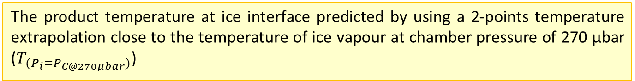








Objective
Prediction ice temperatures at (i) sublimation interface ($T_{i}$) and (ii) vial’s base ($T_{b}$) including qualification TVIS technique ($T_{i}=T_{\left(P_{i}=P_{c}\right)}$)
VII
Temp. constant
($T_{i}$= -33.1± 0.05˚C )
Temp. constant
($T_{i}$= -33.1± 0.05˚C )
Shelf Temperature ${(T}_{s})$
$$T_{b}$$
$$T_{\left(TC\right)1}$$
$$T_{\left(F_{PEAK}\right)BE}$$
$$T_{\left(TC\right)2}$$
$$T_{\left(F_{PEAK}\right)TE}$$
$$T_{i}$$
$$T_{b}$$
$$T_{\left(TC\right)2}$$
$$T_{\left(TC\right)1}$$
$$T_{\left(F_{PEAK}\right)BE}$$
$$T_{(P_{i}=P_{C@270μbar})}=−33.2 ℃$$
$$T_{\left(F_{PEAK}\right)TE}$$
$$T_{i}$$
The product temperature at ice interface predicted by using a 2-points temperature extrapolation close to the temperature of ice vapour at chamber pressure of 270 µbar ($T_{(P_{i}=P_{C@270μbar})}$)

Slide 30
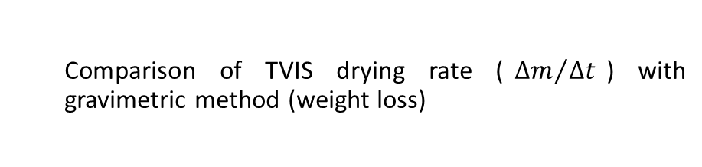
Objective
Comparison of TVIS drying rate (${∆m}/{∆t}$) with gravimetric method (weight loss)
VIII

Slide 31

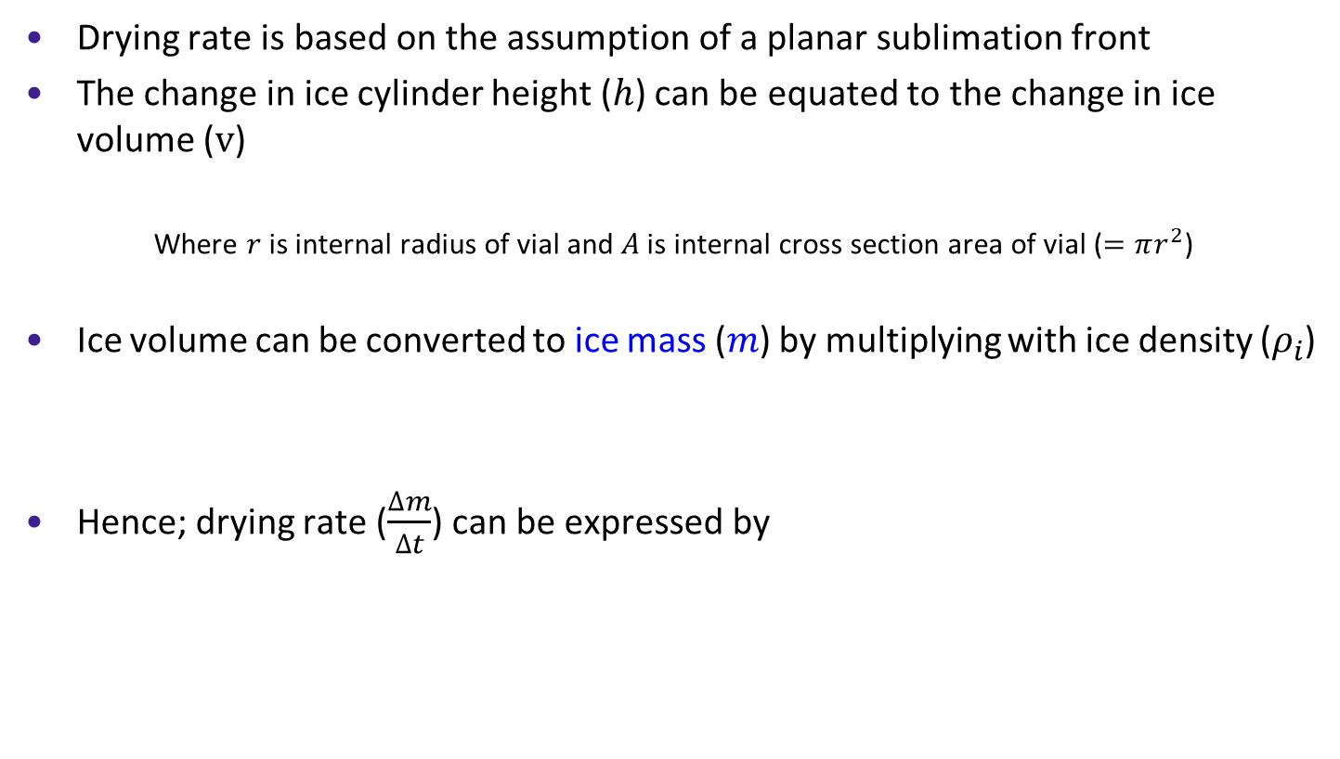
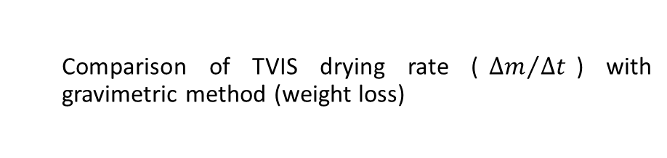
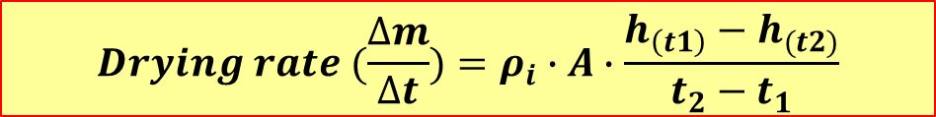

Objective
Comparison of TVIS drying rate (${∆m}/{∆t}$) with gravimetric method (weight loss)
VIII
Drying rate is based on the assumption of a planar sublimation front
The change in ice cylinder height ($h$) can be equated to the change in ice volume ($v$)
Where $r$is internal radius of vial and $A$ is internal cross section area of vial ($=πr^{2}$)
Ice volume can be converted to ice mass ($m$) by multiplying with ice density ($ρ_{i}$)
Hence; drying rate ($\frac{∆m}{∆t}$) can be expressed by
$$v \left(cylinder\right)=πr^{2}h=Ah$$
$$m =ρ_{i}∙πr^{2}h=ρ_{i}∙Ah$$
$$Drying rate (\frac{∆m}{∆t})=ρ_{i}∙A∙\frac{h_{\left(t1\right)}−h_{(t2)}}{t_{2}−t_{1}}$$

Slide 32

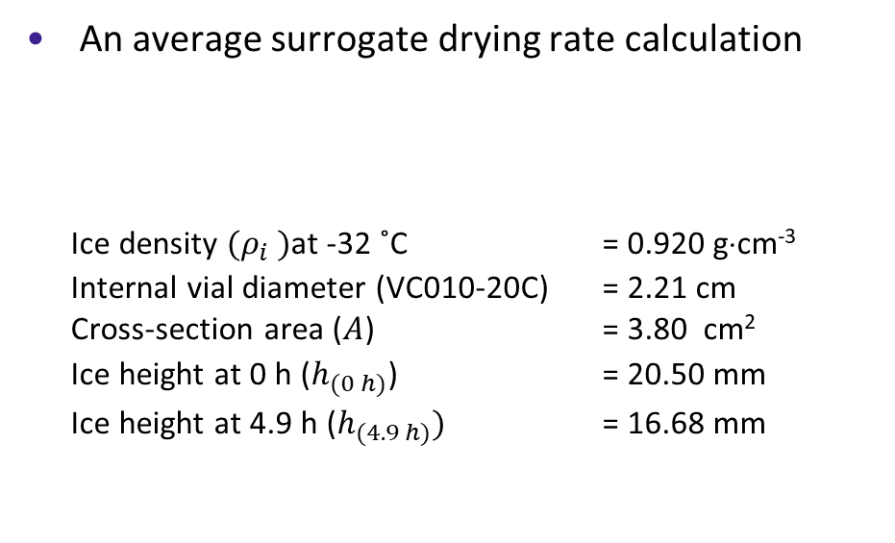
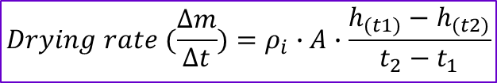



Objective
Comparison of TVIS drying rate (${∆m}/{∆t}$) with gravimetric method (weight loss)
VIII
An average surrogate drying rate calculation
  Ice density ${(ρ}_{i} )$at -32 ˚C = 0.920 g⋅cm⁻³
  Internal vial diameter (VC010-20C) = 2.21 cm Cross-section area ($A$) = 3.80 cm²
  Ice height at 0 h ($h_{(0 h)}$) = 20.50 mm
  Ice height at 4.9 h ($h_{(4.9 h)})$ = 16.68 mm
$h_{(0 h)}$ 20.50 mm
$$Drying rate (\frac{∆m}{∆t})=ρ_{i}∙A∙\frac{h_{(t1)}−h_{(t2)}}{t_{2}−t_{1}}$$
$$h_{(4.9 h)} \text{16.68} \text{mm}$$
  $$Drying rate =0.920 g∙{cm}^{−3}×3.80 {cm}^{2}×\frac{\left(20.50−16.68\right)×{10}^{−1}cm}{\left(4.9−0\right)h}$$
  $=0.27 g∙h^{−1}$
 | $$Drying rate$$
$$TVIS$$ | 0.27 g/h
$$Gravimetric$$ | 0.25 g/h

Slide 33

Objective
Determination (i) the drying rate (${∆m}/{∆t}$) and (ii) ice base temperature ($T_{b}$) during the steady state period
IX

Slide 34











Objective
Determination (i) the drying rate (${∆m}/{∆t}$) and (ii) ice base temperature ($T_{b}$) during the steady state period for heat transfer coefficient ($K_{v})$ calculation
IX
$$T_{b}$$
$T_{avg}$ ~32 ˚C
$$T_{i}$$
Drying rate during the steady state
  Ice density ${(ρ}_{i} )$ at -32˚C = 0.920 g⋅cm⁻³
  (Calculated ice temperature between $T_{i} \&{ T}_{b}\text{)}$
  Internal vial diameter (VC010-20C) = 2.21 cm Cross-section area ($A$) = 3.80 cm²
  Ice height at 2 h ($h_{(2 h)}$) = 19.94 mm
  Ice height at 2.8 h ($h_{(2.8 h)})$ = 18.98 mm
Temp. constant $T_{i}$= -33.1± 0.05˚C
$T_{b}$= -29.8± 0.03˚C
$$Drying rate (\frac{∆m}{∆t})=ρ_{i}∙A∙\frac{h_{(t1)}−h_{(t2)}}{t_{2}−t_{1}}$$
$h_{(2 h)}$ 19.94 mm
$$h_{(2.8 h)} \text{1}\text{8.9}\text{8} \text{mm}$$
TVIS parameters used for determination:
$\frac{∆m}{∆t}$ = 0.42 g·h⁻¹
$T_{b}$= -29.8˚C
$$Drying rate =0.920 g∙{cm}^{−3}×3.80 {cm}^{2}×\frac{\left(19.94−18.98\right)×{10}^{−1}cm}{\left(2.8−2.0\right) h}$$
$$=0.42 g∙h^{−1}$$

Slide 35

Objective
Heat transfer coefficient ($K_{v})$ calculation
X

Slide 36


Objective
Heat transfer coefficient ($K_{v})$ calculation
X
Parameters | TVIS
Drying rate at steady state (g/h) (2-2.8 h into primary drying) | 0.42
Shelf Temperature, $T_{s}$ (K) | 273.3
Vial’s base Temperature, $T_{b}$(K) | 243.3
Notes:
Freezing -40 C
Annealing -10 C
Drying -20 C

Slide 37






Objective
Heat transfer coefficient ($K_{v})$ calculation
X
Parameters | TVIS
Drying rate at steady state (g/h) (2-2.8 h into primary drying) | 0.42
Shelf Temperature, $T_{s}$ (K) | 273.3
Vial’s base Temperature, $T_{b}$(K) | 243.3
$K_{v}($TVIS @ 270 μbar)
5.73 x 10⁻⁴
$$L\frac{∆m}{∆t}=A_{e}K_{v}(T_{s}−T_{b})$$
$$K_{v}=\frac{L\frac{∆m}{∆t}}{A_{e}(T_{s}−T_{b})}$$
$$K_{v}(270 μbar)=\frac{L\frac{∆m}{∆t}}{A_{e}(T_{s}−T_{b})}$$
$$=\frac{679.7 cal∙g^{−1}×0.42 g∙h^{−1}}{4.62 {cm}^{2}×\left(273.3−243.3\right)K}$$
$L$ is the latent heat of sublimation of ice (2844 J⋅g⁻¹ or 679.7 cal ⋅g⁻¹) and $A_{e}$is external cross-sectional area of the base of the TVIS vial (4.62 cm²)
$$=2.06 cal∙h^{−1}∙{cm}^{−2}∙K^{−1}$$
$$=5.73×{10}^{−4}cal∙s^{−1}∙{cm}^{−2}∙K^{−1}$$
Pikal, et al. (1984)
$$K_{v}(270 μbar)=5.73×{10}^{−4}cal∙s^{−1}∙{cm}^{−2}∙K^{−1}$$
Notes:
Freezing -40 C
Annealing -10 C
Drying -20 C

Slide 38
Additional comments
Qualification of steady state heat transfer mechanisms

Slide 39


A single vial technique
Pikal, et al. (1984)
The mean sublimation rate was calculated from the mass of ice sublimed and the time required for sublimation.
Notes:
[1] M. Pikal, M. Roy, S. Shah, Mass and heat transfer in vial freeze‐drying of pharmaceuticals: Role of the vial, J. Pharm. Sci. 73 (1984) 1224-1237.
[2] S. Hibler, C. Wagner, H. Gieseler, Vial freeze-drying, part 1: New insights into heat transfer characteristics of tubing and molded vials, J. Pharm. Sci. 101 (2012) 1189-1201.
[3] B. Scutella, S. Passot, E. Bourles, F. Fonseca, I.C. Trelea, How Vial Geometry Variability Influences Heat Transfer and Product Temperature During Freeze-Drying, J. Pharm. Sci. 106 (2017) 770-778.

Slide 40

Assumption for $K_{v}$ determination
How do we know that the heat transfer mechanisms are constant up to 25% loss of ice mass?
If the heat transfer mechanisms change because of ice- glass interface contact or because of the change of ice shape (surface area) then surely heat transfer coefficient will change?
It requires a technique to qualify when the heat transfer mechanisms change
So can TVIS demonstrate when ice leaves the glass wall interface?

Slide 41

Limitation of TVIS System ?
I
II
$$T_{b}$$
$T_{avg}$ ~32 ˚C
$$T_{i}$$
Temp. constant $T_{i}$= -33.1± 0.05˚C
$T_{b}$= -29.8± 0.03˚C

Slide 42

Discussion
Decrease in $F_{PEAK}$ suggests that the temperature may be decreasing after the steady state period, contrary to accepted knowledge that the temperature starts to increase owing to a reduction in drying rate and hence the degree of self cooling
Decrease in $F_{PEAK}$ is more likely to be due to a change in the ice-glass contact associated with a change in the shape of the ice cylinder.
Conclusion
The period for determining the drying rate should be decreased from 25% ice loss to 10% for TVIS to give reliable estimates for Kv
Opportunity to cycle through shelf temperature and chamber pressure to create the design space for Kv determinations as a function of shelf position.

Slide 43

Limitations
$C_{PEAK}^{″}$and $F_{PEAK}$parameters rely on intimate contact of ice cylinder with glass wall
Cable length limited to 1m at present
C-TVIS not compatible with front loading system
Incompatible with TCs in same TVIS vial (use fibre optic sensors – INFAP)

Slide 44



Future Work
Development dryer mapping of sublimation characteristics
  heat transfer coefficients ($K_{V}$)
  dry layer resistance ($R_{P}$)
Instrument Development
  Contact C-TVIS instrument (2018)
  Non-contact TVIS (2018-19)
    Micro-well screening
    Vial clusters in batch FD
  TVIS - Shuttle (2019-20)

Slide 45










Acknowledgements, Recent Projects & Collaborators
De Montfort University, School of Pharmacy
  Evgeny Polygalov: co-inventor of TVIS instrument
  Yowwares Jeeraruangrattana. PhD student
  Bhaskar Pandya. PhD student
  Irina Ermolina. Senior Lecturer
LyoDEA
Lyophilization process analytics
By dielectric analysis
Government Support for industry
Biopharmaceutical Stability at
Room Temperature
Analytical Technologies for the
Stabilization of Biopharmaceuticals

Slide 46
Thank you

