Slide 1



UN Chinese Language Day
Chinese Calligraphy Workshop
中国书法工作坊
（zhōng guó shū fǎ gōng zuò fáng）
王深 Wang Shen

Slide 2
Chinese Calligraphy Styles 书体（shū tǐ）
The Maintenance of Brush 执笔（zhí bǐ）
The Strokes 笔画（bǐ huà）
Orders of Strokes 笔顺（bǐ shùn）
Some Personal Experiences
Demonstration

Slide 3
Chinese Calligraphy Styles 书体（shū tǐ）
The Maintenance of Brush 执笔（zhí bǐ）
The Strokes 笔画（bǐ huà）
Orders of Strokes 笔顺（bǐ shùn）
Some Personal Experiences
Demonstration

Slide 4
Chinese Calligraphy
中国书法（zhōng guó shū fǎ）
Chinese Calligraphy is the cornerstone of Chinese culture. Using brushes and pine-soot ink, the beauty of characters is expressed in thickness change between pressure and release. Although thousands of characters are used in daily life, they can all be divided into different types.

Slide 5
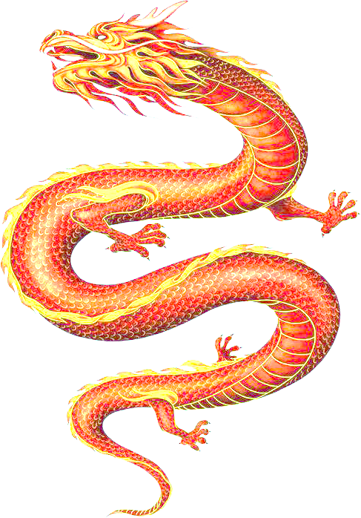
Chinese Calligraphy Styles
书体（shū tǐ）- Historical Evolution

Slide 6
Chinese Calligraphy Styles
书体（shū tǐ）- Genres

Slide 7
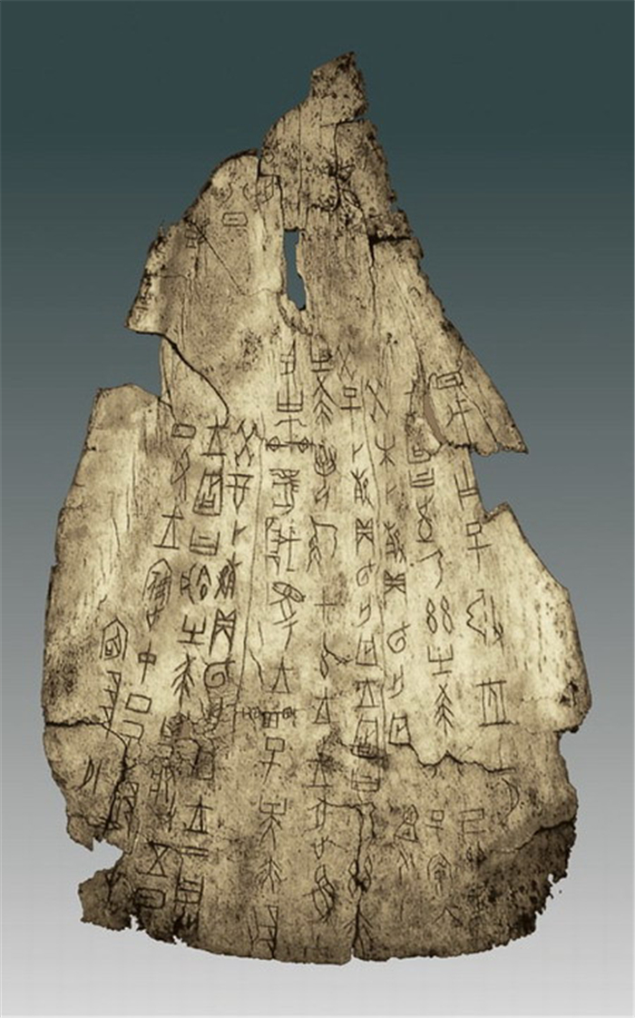
Chinese Calligraphy Styles
书体（shū tǐ）
甲骨文 jiǎ gǔ wén
(Oracle)
1700 B.C
Inscriptions on bones or tortoise shells of the Shang Dynasty

Slide 8
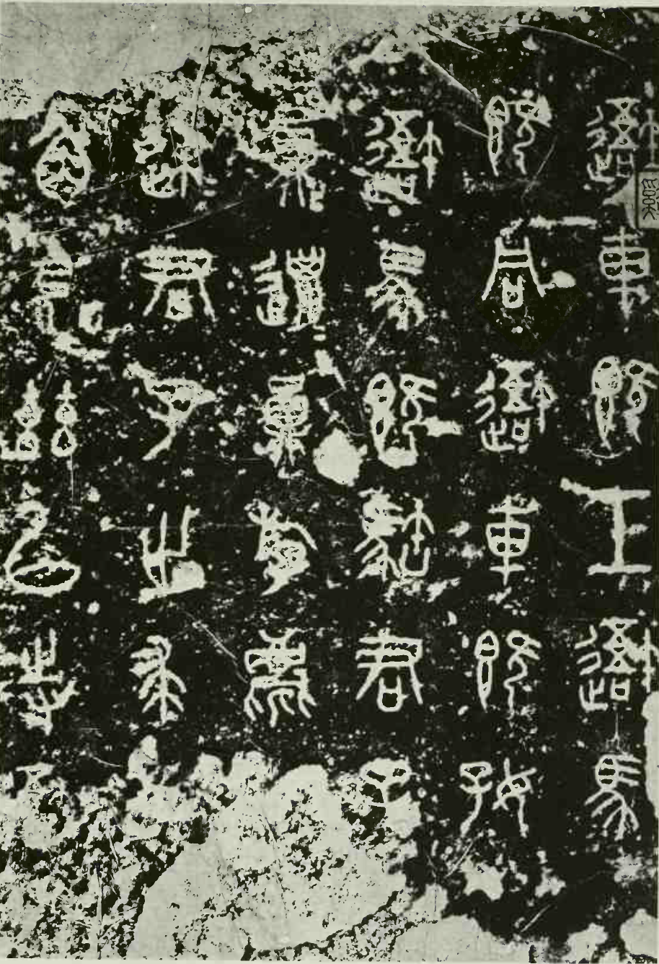
Chinese Calligraphy Styles
书体（shū tǐ）
大篆书 dà zhuàn shū
(Large Seal Script)
石鼓文 shí gǔ wén
Inscriptions on drum-shaped stone blocks of the Warring States Period

Slide 9
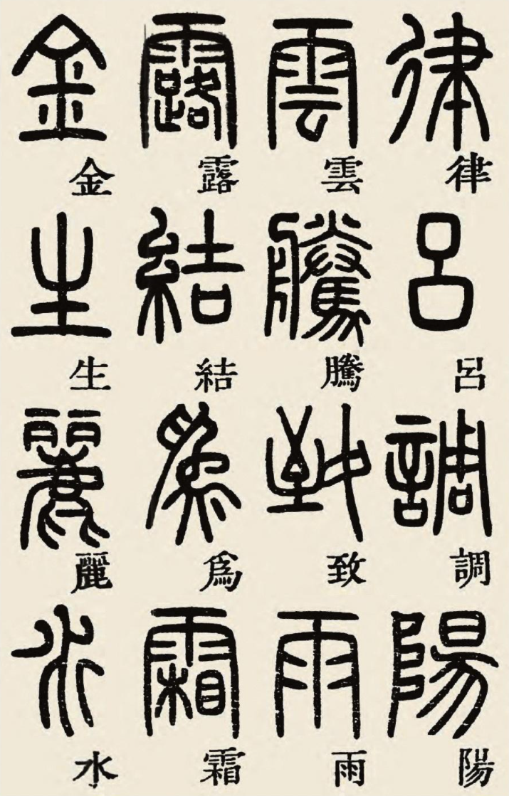
Chinese Calligraphy Styles
书体（shū tǐ）
小篆书 xiǎo zhuàn shū
(Small Seal Script)
More precise; neatly written in grids

Slide 10
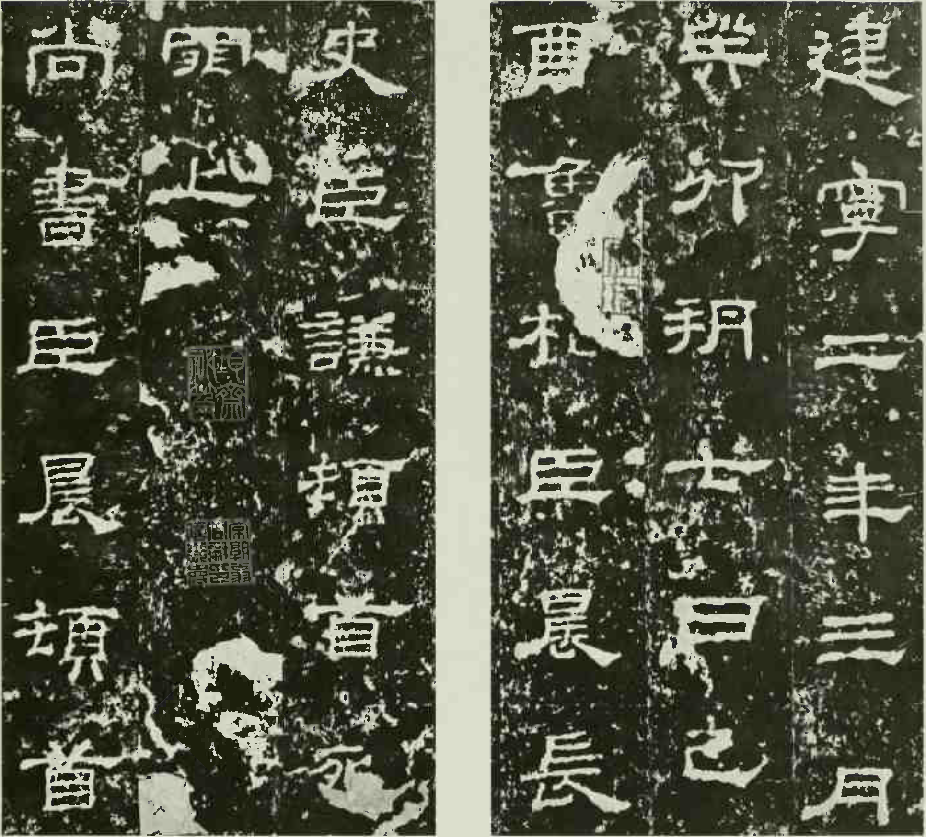
Chinese Calligraphy Styles
书体（shū tǐ）
隶书 lì shū
(Official Script
or Scribal Script)
Before paper was invented in China, materials used for writing are bamboos, fabrics of silk, or carved stones

Slide 11
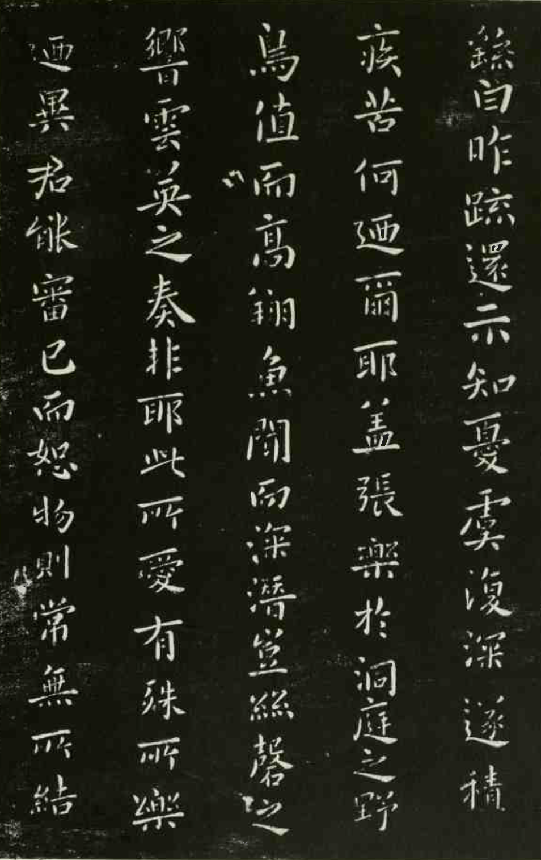
Chinese Calligraphy Styles
书体（shū tǐ）
楷书 kǎi shū
(Regular Script)
During the Wei dynasty, the regular script had begun to evolve from the
official script, for which 钟繇zhōng yáo was at first noted.

Slide 12
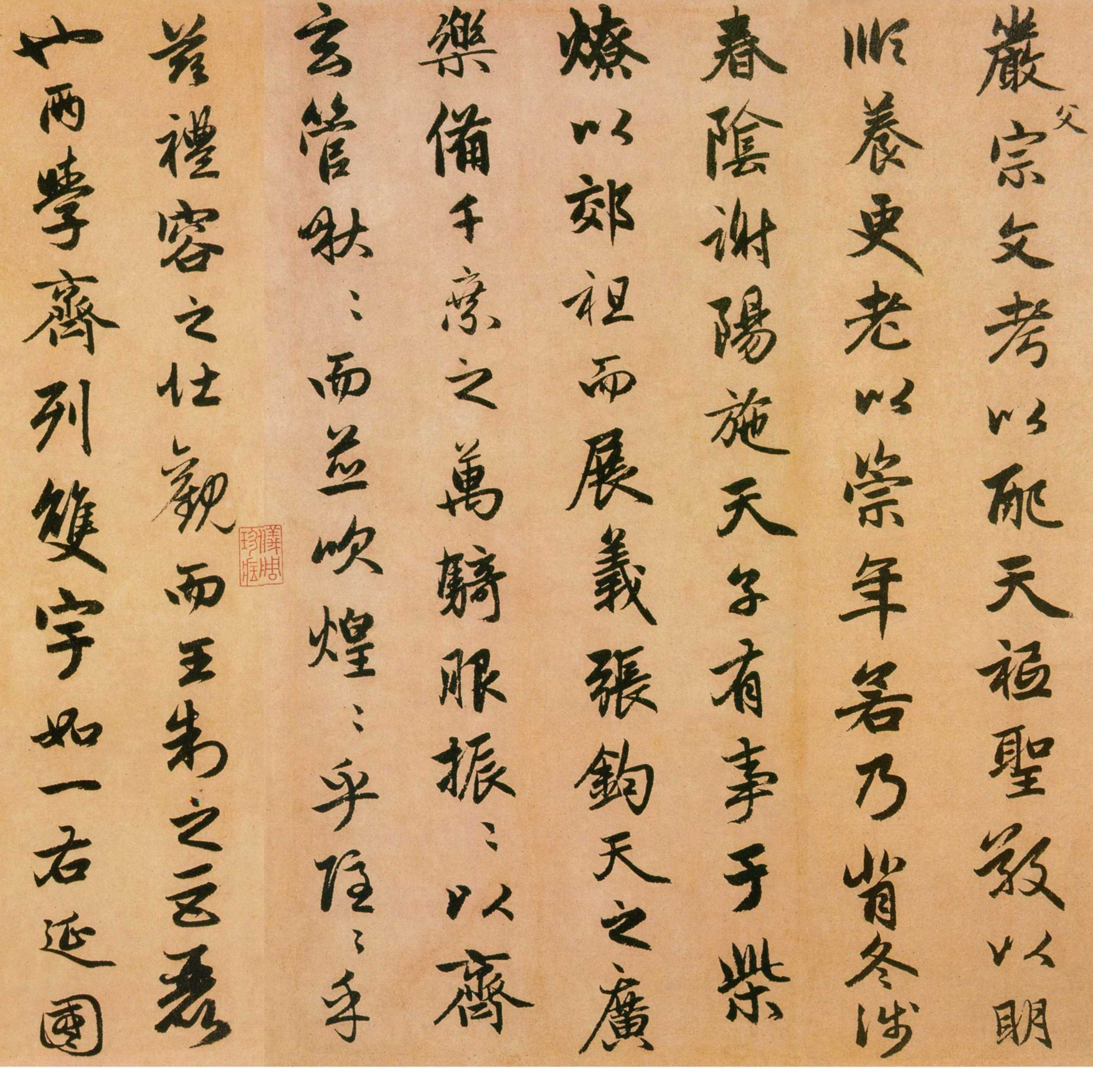
Chinese Calligraphy Styles
书体（shū tǐ）
行书 xíng shū
(Cursive Script)
The development of cursive script is attributed to 张芝zhāng zhī (A.D. 200) in the Later Han dynasty. It is a form of shorthand writing. Shortcuts are taken in the number of the strokes in regular script characters, which become abbreviated into curves and dots.

Slide 13
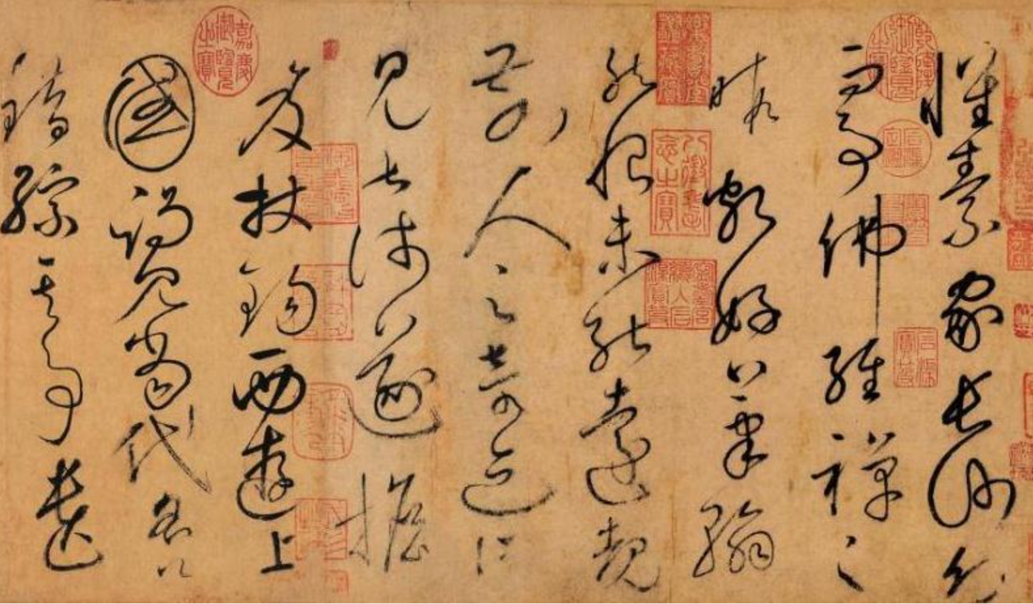
Chinese Calligraphy Styles
书体（shū tǐ）
草书 cǎo shū
(Wild cursive script)
The lines spring light-footed; the curves are rolling loops.
The brush flies as in a fury; the strokes are as snakes striking.

Slide 14
Chinese Calligraphy Styles 书体（shū tǐ）
The Maintenance of Brush 执笔（zhí bǐ）
The Strokes 笔画（bǐ huà）
Orders of Strokes 笔顺 bǐ shùn
Some Personal Experiences
Demonstration

Slide 15
The Maintenance of Brush
执笔（zhí bǐ）
Holding the brush correctly can make writing more effortless and flexible
Try not to hold the brush too hard.
Collaborate with your fingers, wrists and elbows as you write
You can practice the brush movement simply by drawing straight horizontal / vertical / slant lines, and circles

Slide 16
Chinese Calligraphy Styles 书体（shū tǐ）
The Maintenance of Brush 执笔（zhí bǐ）
The Strokes 笔画（bǐ huà）
Orders of Strokes 笔顺（bǐ shùn）
Some Personal Experiences
Demonstration

Slide 17
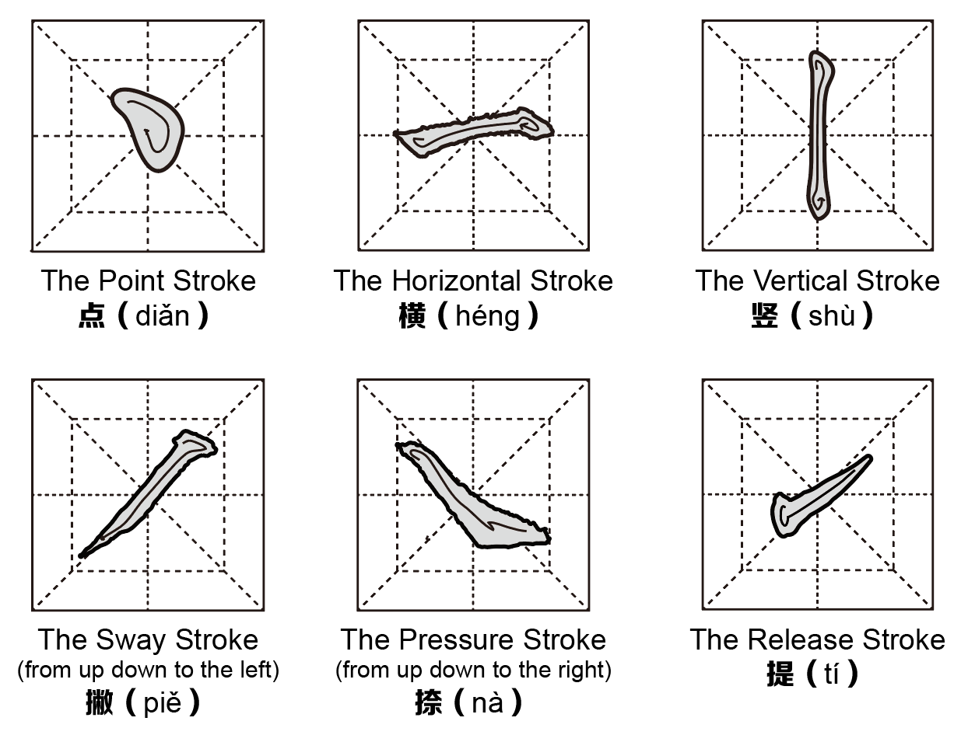
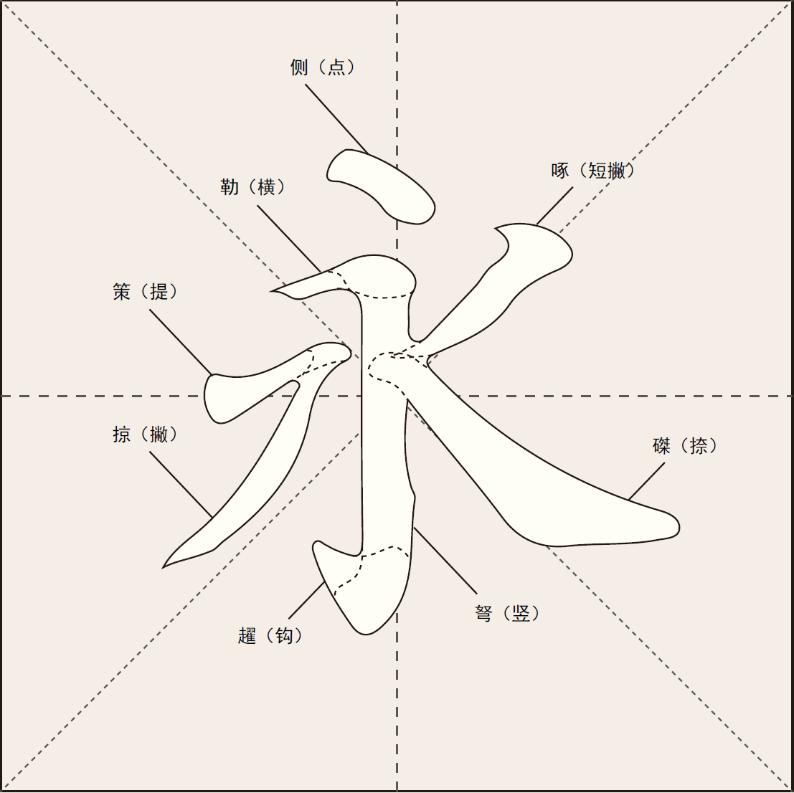
The Basic Strokes
基本笔画
jī běn bǐ huà

Slide 18
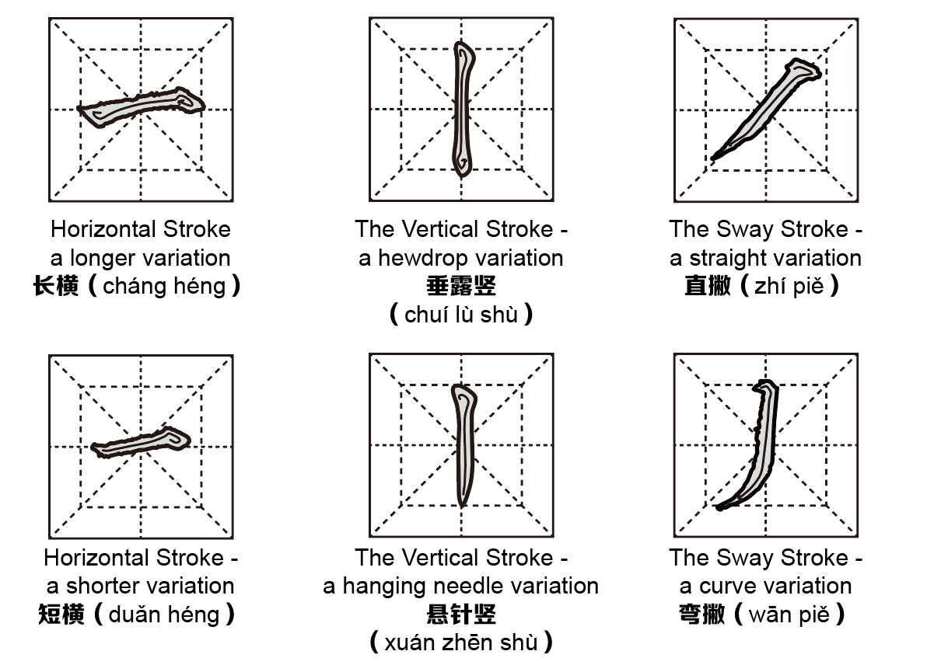
Variation Strokes - Different Forms
基本笔画
jī běn bǐ huà

Slide 19
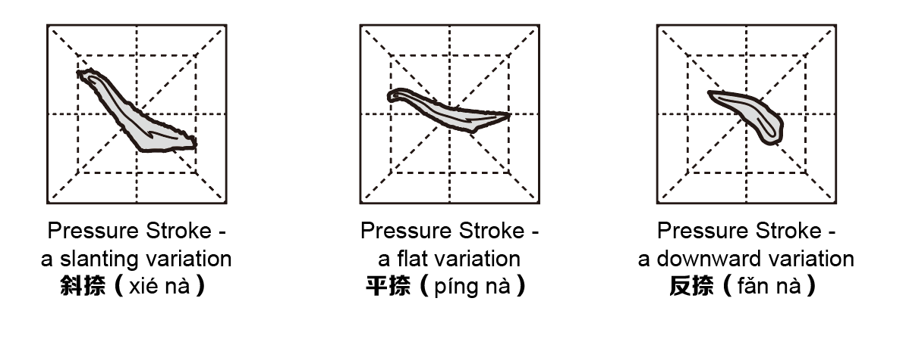
Variation Strokes - Different Forms
基本笔画
jī běn bǐ huà

Slide 20
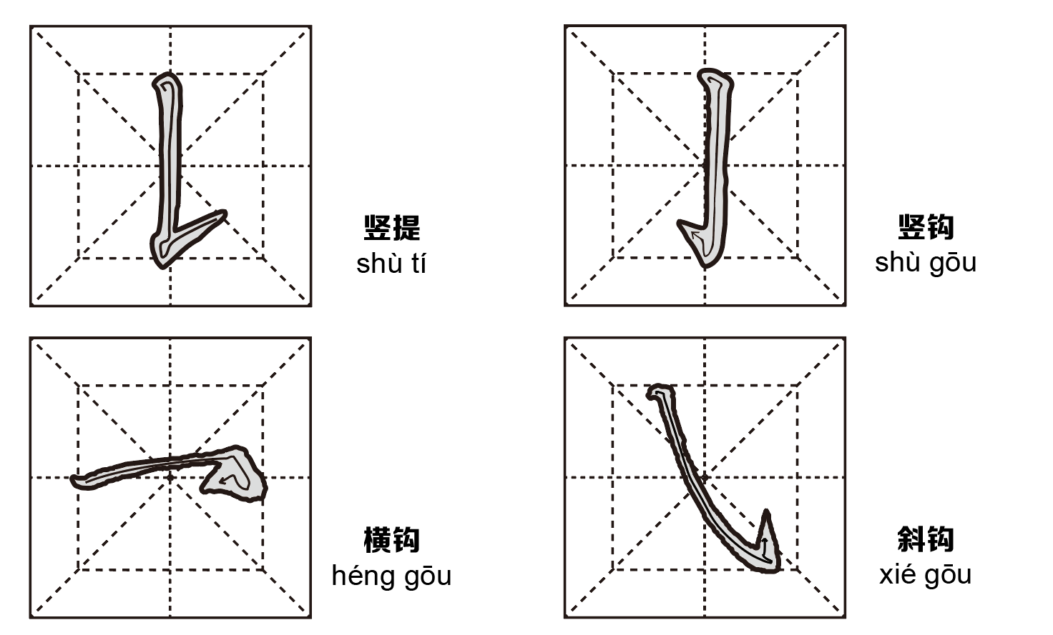
Variation Strokes- Combinations
基本笔画
jī běn bǐ huà

Slide 21
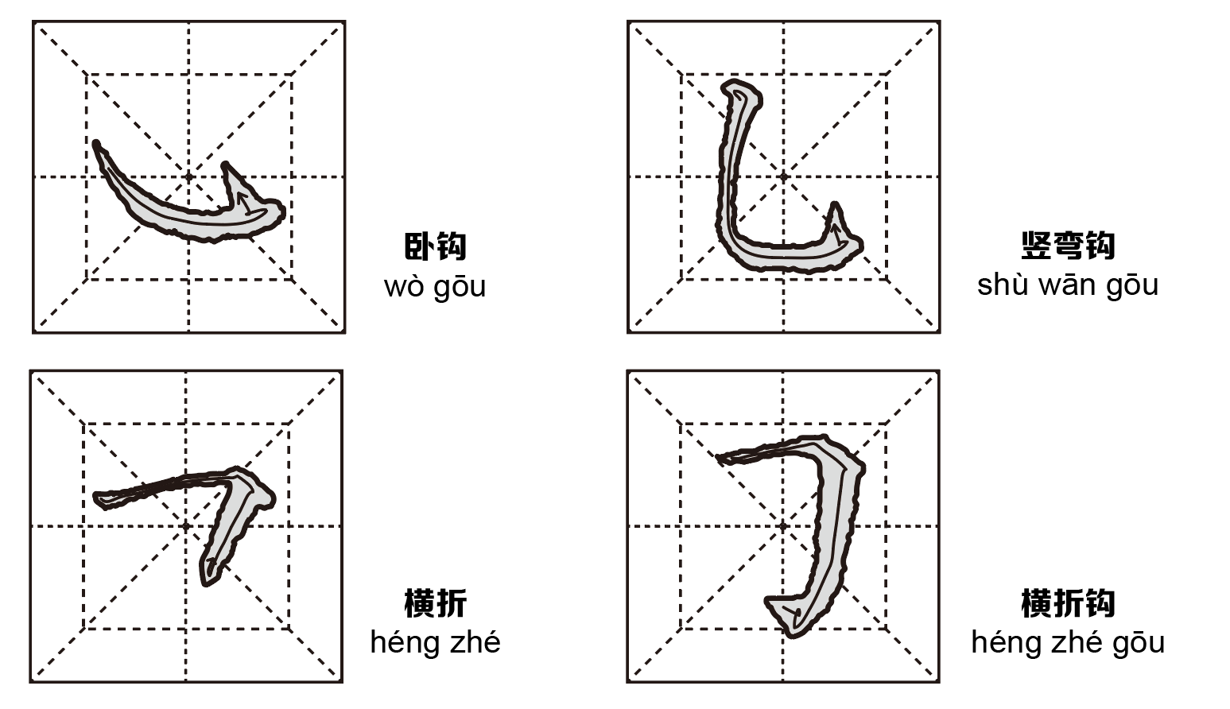
Variation Strokes- Combinations
基本笔画
jī běn bǐ huà

Slide 22
Chinese Calligraphy Styles 书体（shū tǐ）
The Maintenance of Brush 执笔（zhí bǐ）
The Strokes 笔画（bǐ huà）
Orders of Strokes 笔顺 bǐ shùn
Some Personal Experiences
Demonstration

Slide 23
Orders of Strokes
笔顺 bǐ shùn
Orders of writing matter most in calligraphy. Following the right sequence of strokes can make you write smoothly and beautifully. In a broader sense, strokes are arranged in a top-down, left-right way. Beside this, there are a number of specific yet sometimes contradictory rules:
1. Horizontal first, then vertical
e.g. 十、丰
2. Sway first, then pressure
e.g. 人、衣
3. Horizontal & vertical precede sway & pressure
e.g. 木、来
4. Middle first, then left and right
e.g. 水、小
5. Outside first, then inside
e.g. 回、目

Slide 24
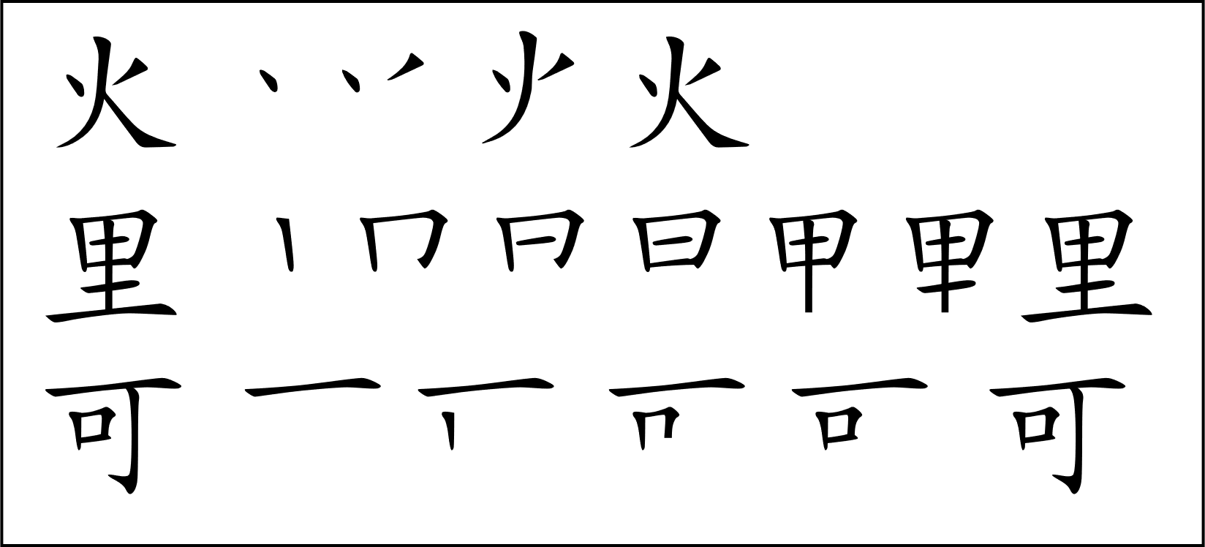
Orders of Strokes
笔顺 bǐ shùn
Orders of writing matter most in calligraphy. Following the right sequence of strokes can make you write smoothly and beautifully. In a broader sense, strokes are arranged in a top-down, left-right way. Beside this, there are a number of specific yet sometimes contradictory rules:
Examples:

Slide 25
Chinese Calligraphy Styles 书体（shū tǐ）
The Maintenance of Brush 执笔（zhí bǐ）
The Strokes 笔画（bǐ huà）
Orders of Strokes 笔顺（bǐ shùn）
Some Personal Experiences
Demonstration

Slide 26
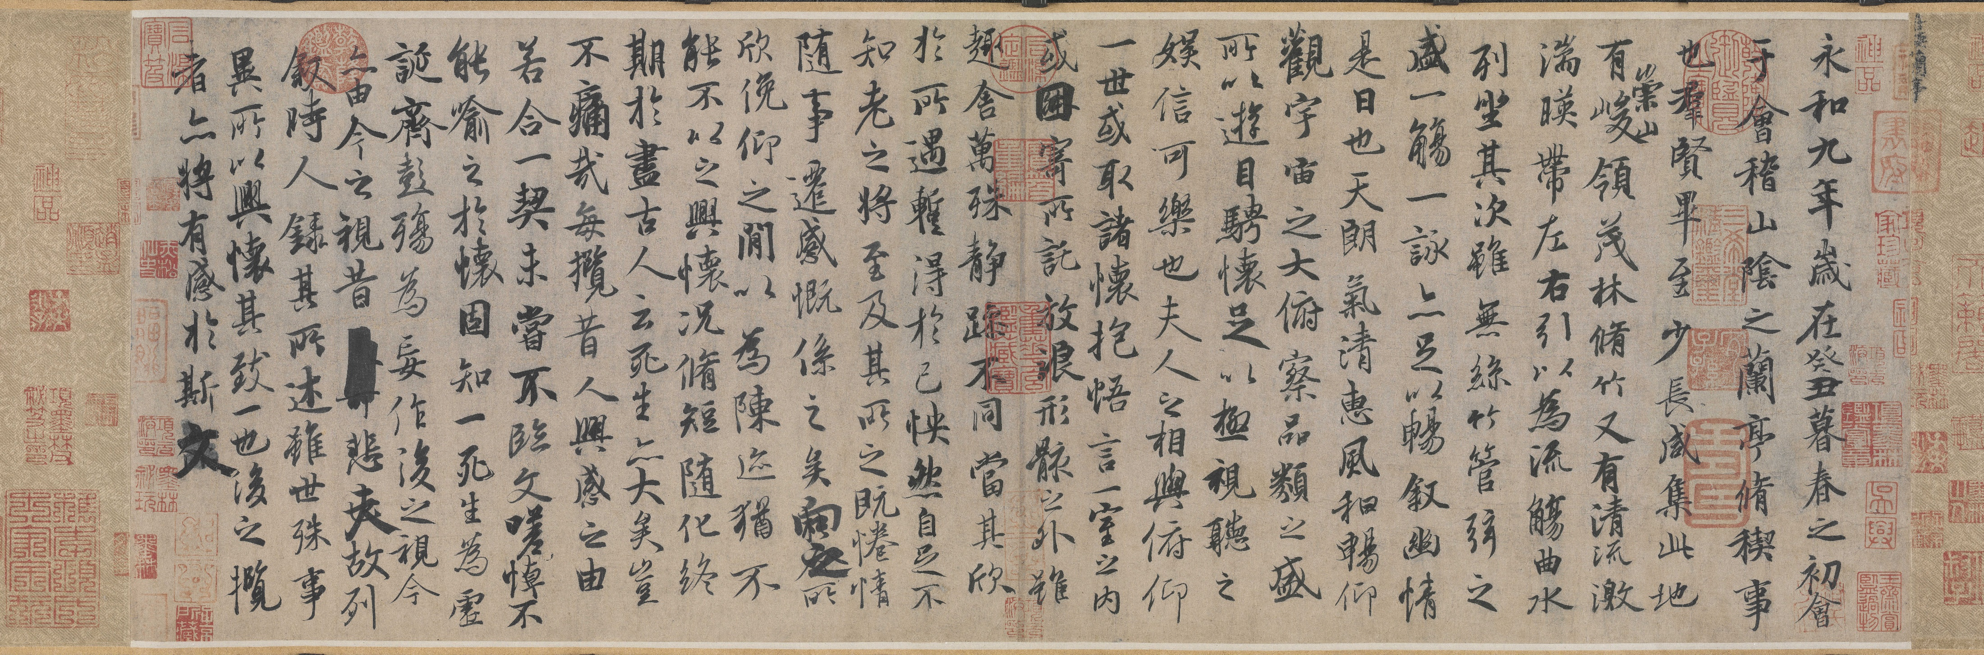
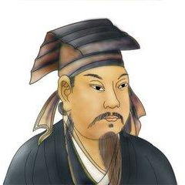
Reaching with the ancients 与古为徒 yǔ gǔ wéi tú
兰亭序（lán tíng xù）
Preface to the Poems Collected from the Orchid Pavilion
王羲之（Wang Xizhi）353 A.D – East Jin Dynasty

Slide 28
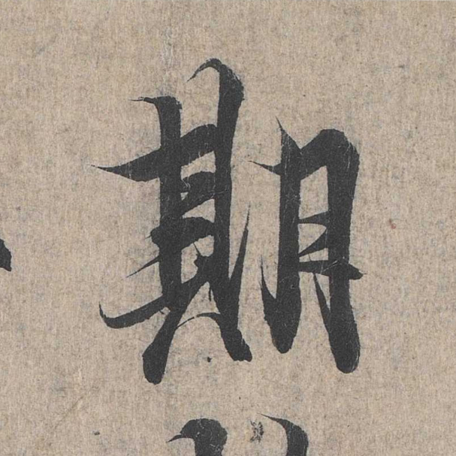
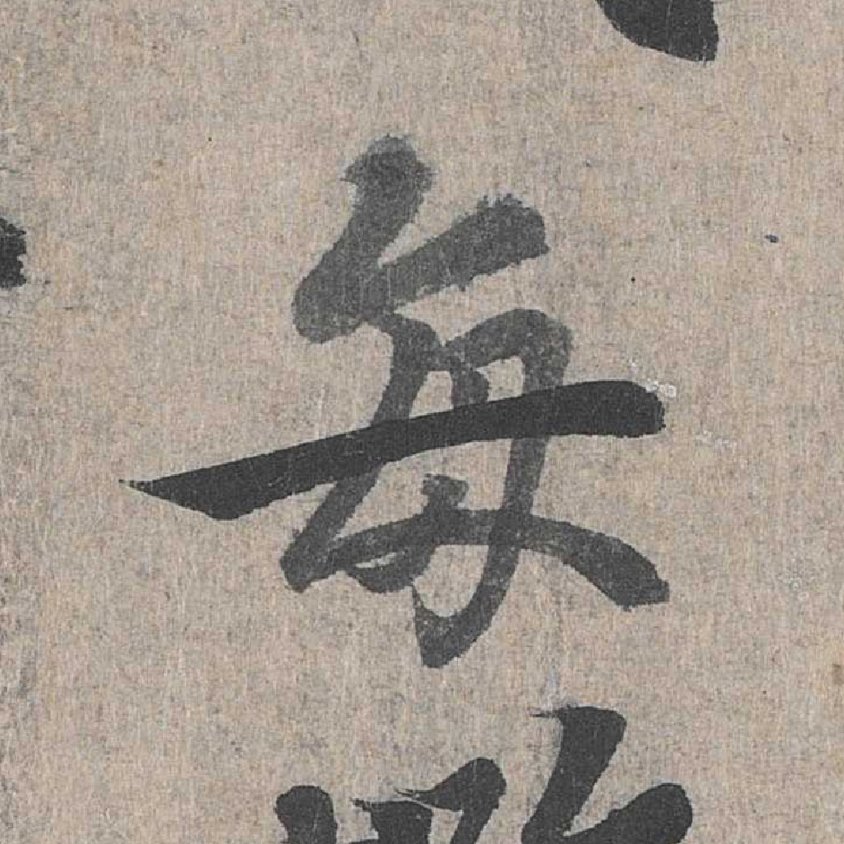
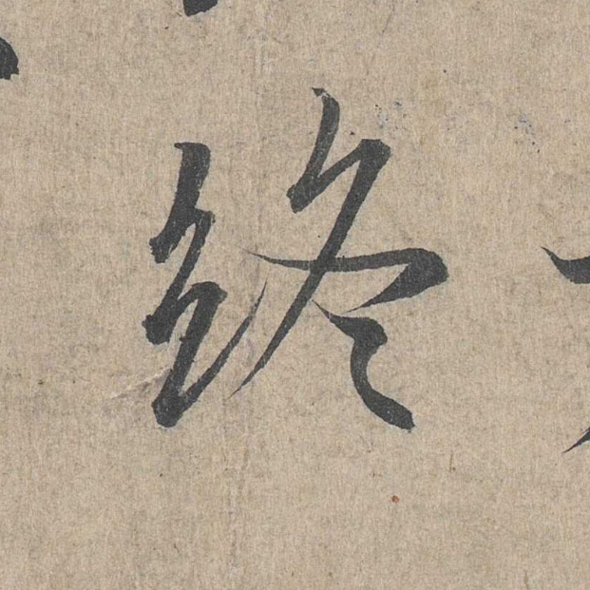

Slide 29
Soak the brush
soak again

Slide 30
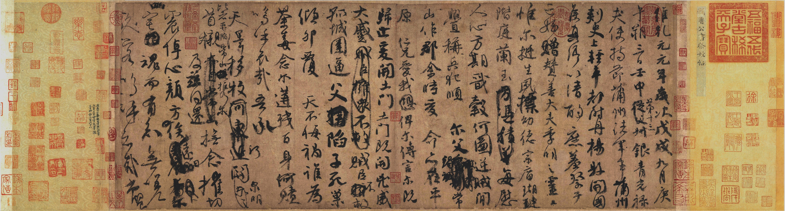
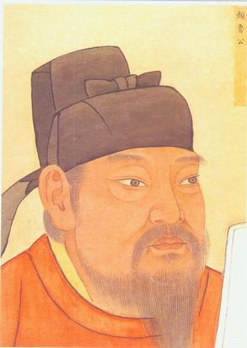
Reaching with ancient sages 与古为徒 yǔ gǔ wéi tú
祭侄文稿（jì zhí wén gǎo）
The Manuscript / Draft of the Funeral Address for Yan Zhenqing’s Nephew
755 A.D – Tang Dynasty
颜真卿（yán zhēn qīng）

Slide 31
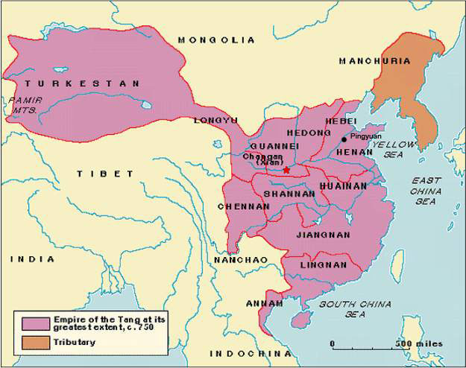
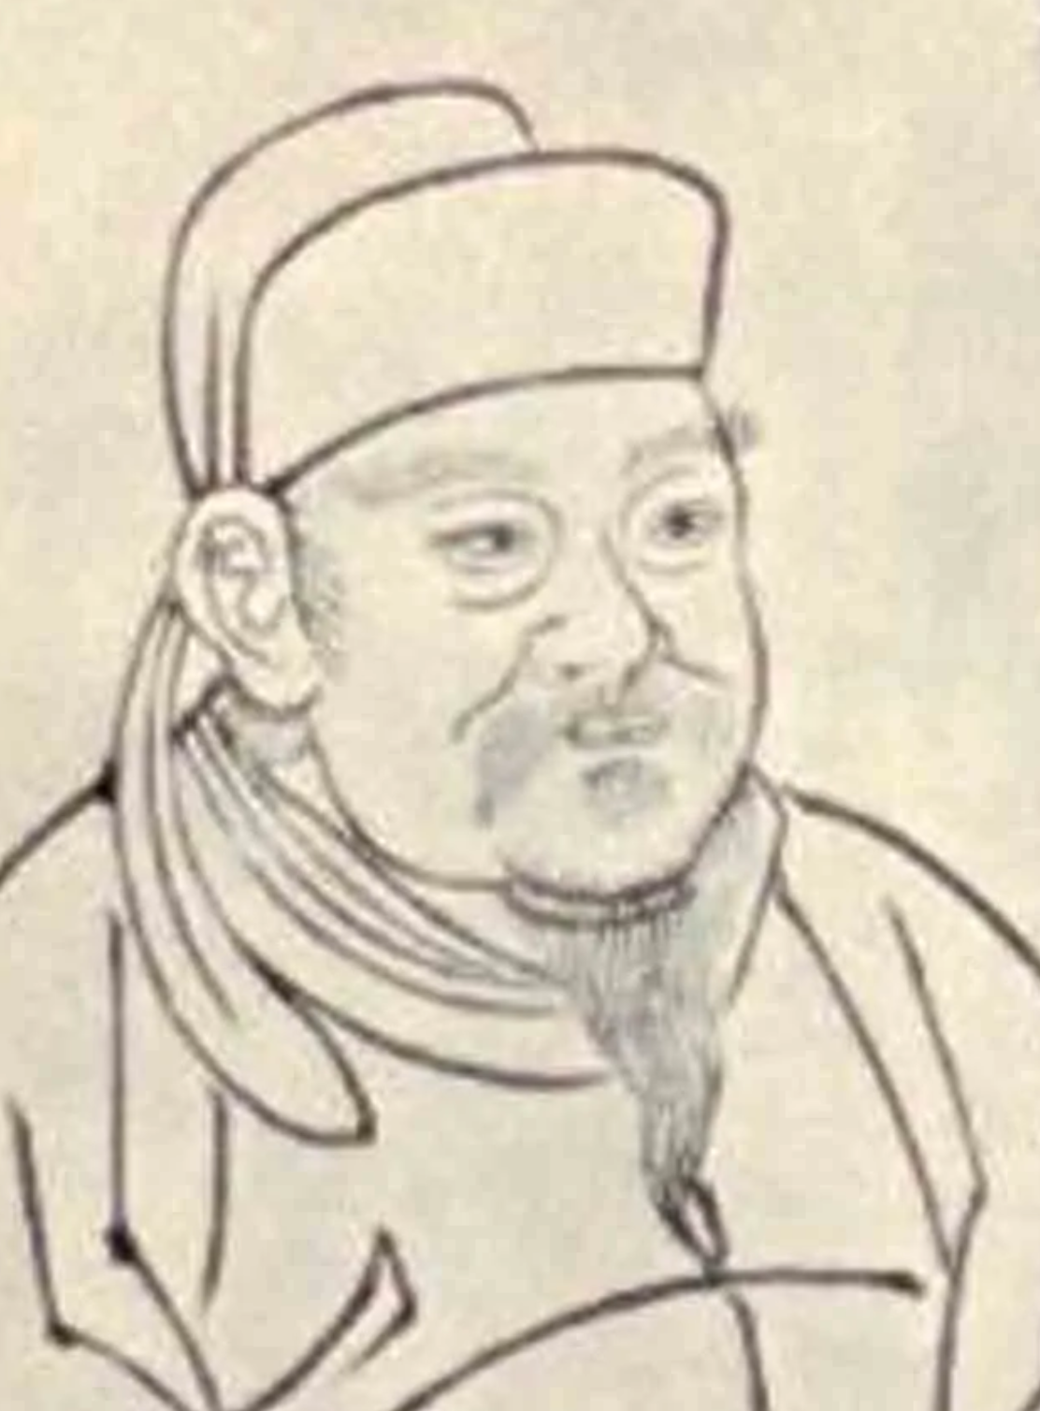
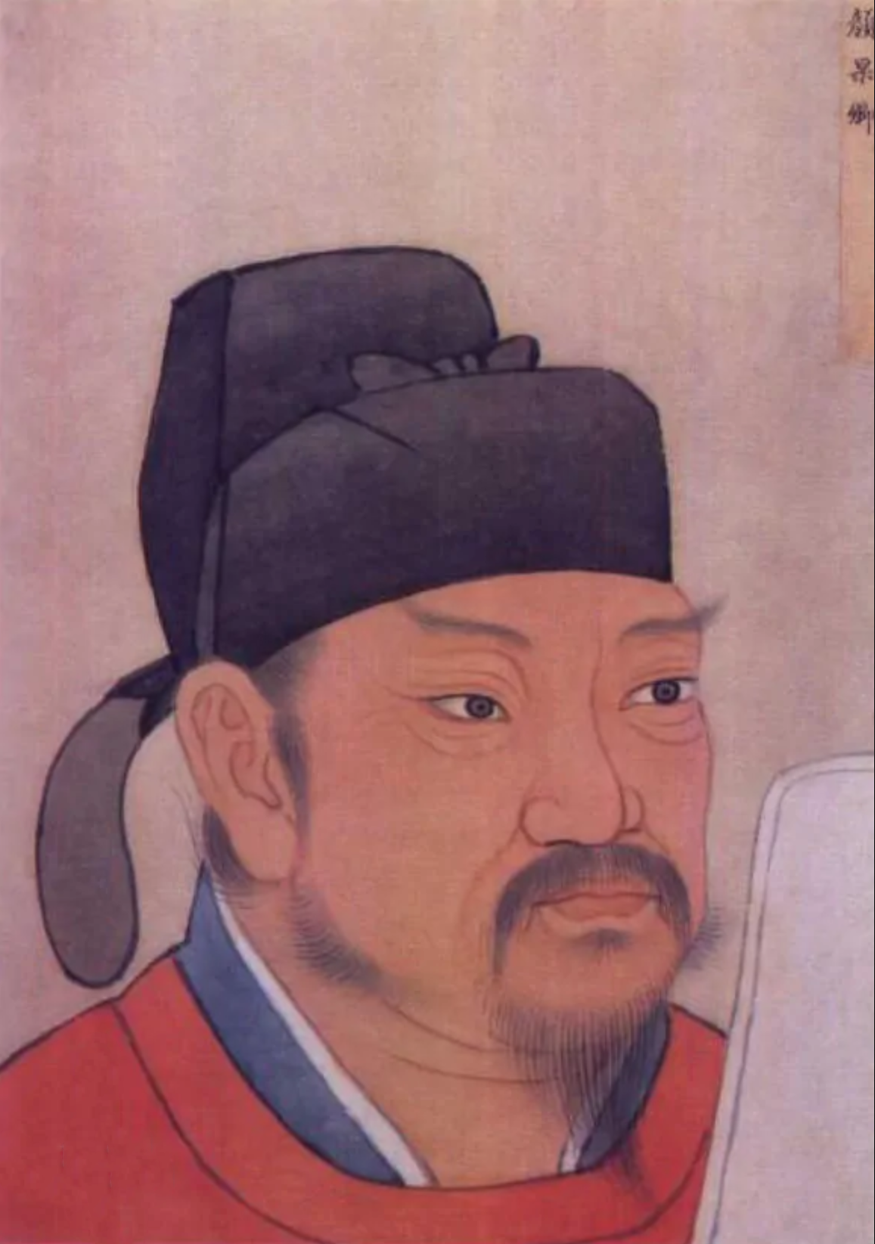
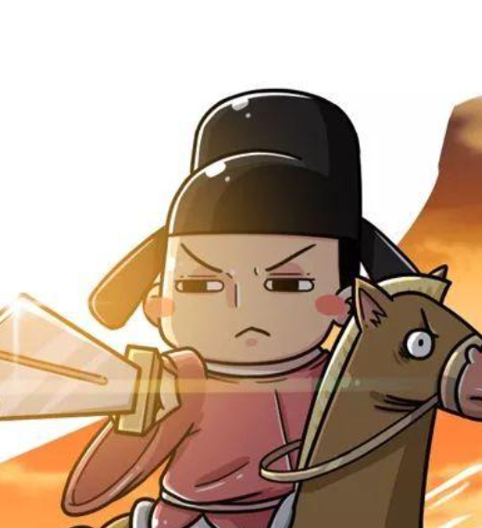
An Lushan
Yan Zhenqing
Yan Gaoqing
(Cousin)
Yan Jiming
(Son)

Slide 32
Reaching with ancient sages 与古为徒 yǔ gǔ wéi tú
祭侄文稿（jì zhí wén gǎo）
The Manuscript / Draft of the Funeral Address for Yan Zhenqing’s Nephew
755 A.D – Tang Dynasty
颜真卿（yán zhēn qīng）

Slide 33
Chinese Calligraphy Styles 书体（shū tǐ）
The Maintenance of Brush 执笔（zhí bǐ）
The Strokes 笔画（bǐ huà）
Orders of Strokes 笔顺（bǐ shùn）
Some Personal Experiences
Demonstration

Slide 34
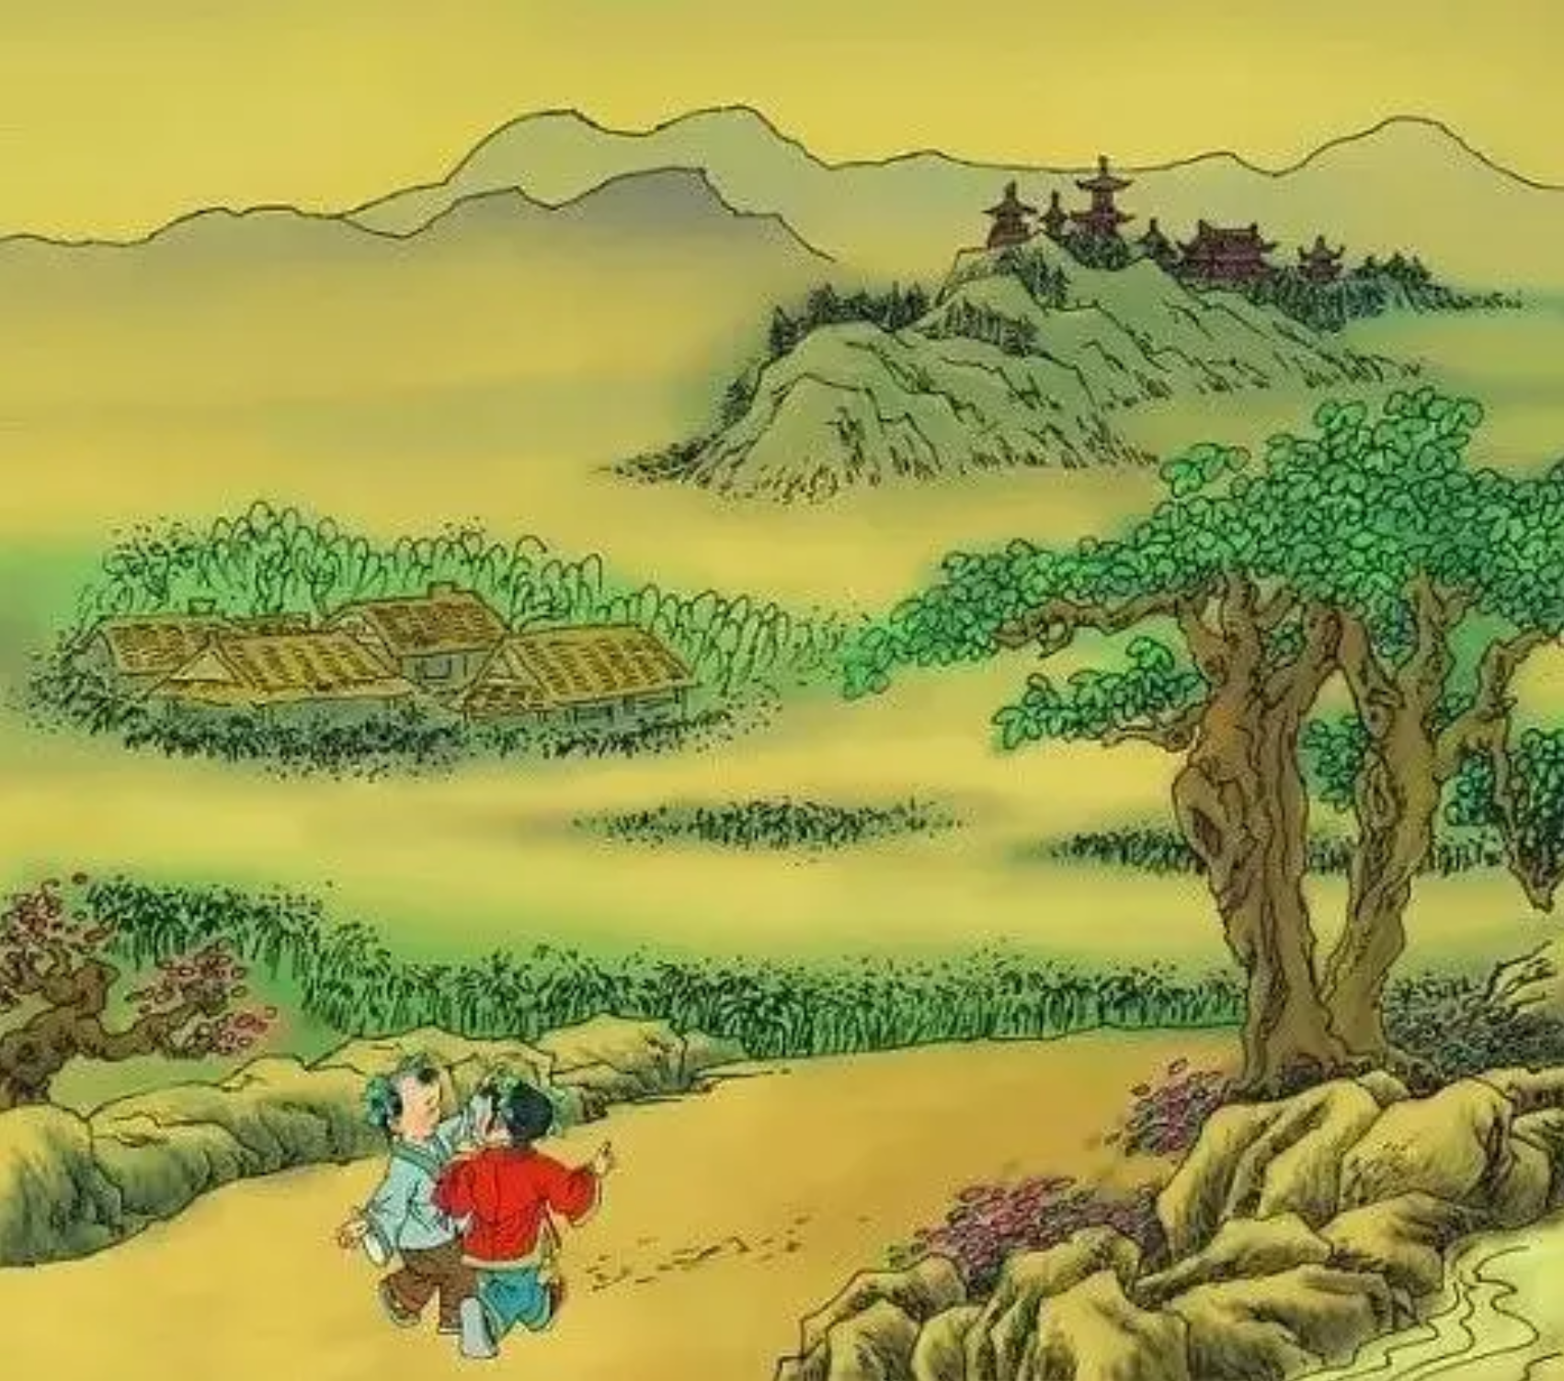

Slide 35
Ode to a Village
You can see two or three miles at one glance,
four or five houses with smoking chimneys.
Six or seven pavilions, and eight,
nine or ten flowers possibly.

