Slide 1
External Examiner Briefing Session
2021/22
Notes:
Head of DAQ Intro (if available)/Quality Officer (Ex Ex) – 10 minutes for slide 1 & 2
Welcome and introduce self
Thank you for attending this induction session and also for agreeing to be an external examiner for DMU
We value your feedback – your comments and judgements are used to inform and improve what we do and the external examining
function underpins all our quality processes. We also hope that by the end of your tenure, you will have got something out of being an external examiner at DMU too.
Hope you find the session useful
Please ask lots of questions – the more interactive this session, the better
Run through of how we hope this session is going to work.

Slide 2





Virtual training session rules and etiquette! This session is being recorded for training purposes
Cameras on
Meet accessibility needs
Increases engagement
Provides visual feedback
Mute microphone
Minimises interference
Reduces background noise
Switch on when speaking!
Questions?
Raise a hand
Write “comment” in chat function
Speaking
One at a time
Introduce yourself
Speak clearly and slowly
Notes:
Louise
Cameras on – seeing other meeting participants not only helps engagement levels, but also assists with meeting accessibility needs
Mute your microphone when you’re not talking – this helps minimise interference and background noise – but remember to switch it back on when you
wish to contribute
Speaking up – questions – raise hand or write a comment. We’ll be stopping at various points to check the chat. Introduce yourself. Be mindful when
others are speaking and try not to interrupt someone mid-sentence . Speak clearly and slowly
Be seated and stay present – try not to get distracted or engage in anything else (including eating!) – handwrite notes instead of typing, where possible
Captions function – turn on for real time subtitles.
Recording – The session will be recorded for training purposes and to share with non-attendees
Introduce presenters, Gita
Some DMU staff – here for developmental purposes
22 external examiners in attendance from all faculties
17 covering our UG provision
5 covering PG provision
Come from 18 institutions
17 with previous external examining experience
5 appointed with a mentor in your first year. May have been appointed a mentors as you don’t have any ex ex experience at all, some of
you may have been an ex ex for a short period of time, or you haven’t been an ex ex for a long time. Mentor details in your appointment letter.
There to support you so drop them an email.
Before I hand over to Nikki, I’ll start the recording. RECORD

Slide 3
What are we covering?
The role of the external examiner - Dr Nicola Brooks (Associate Dean Academic, Faculty of Health and Life Sciences)
Assessment boards - Sally Lloyd (Senior Officer, Taught Programmes), DAQ)
The Academic Regulations – Sally Lloyd (Senior Officer, Taught Programmes), DAQ)
External examiner reports - Louise Newell (Quality Officer (External Examiners/Awarding Bodies), DAQ)
About DMU - Dr Nicola Brooks (Associate Dean Academic, Faculty of Health and Life Sciences)
Notes:
Claire/Nikki
What are we covering?
Read out bullet points. Will appear individually on the presentation

Slide 4
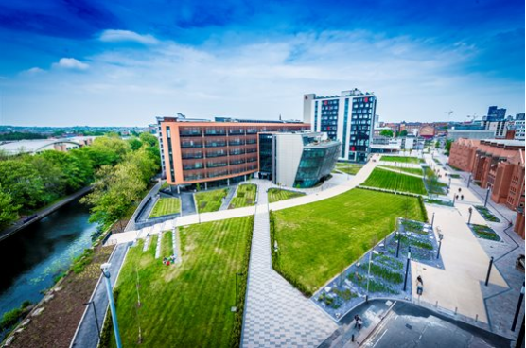


About DMU
PVC Dean / Deputy Dean
Associate Dean Academic (ADA)
Associate Professor Student Experience (APSE)
Associate Professor Quality (APQ)
4 faculties
Head of School / Department
Programme / Subject / Module Leader
325 external examiners
Director of Faculty Operations
28 collaborative partners
Programme Administrator
20,000 students
Notes:
About DMU – Keep this brief. 10 minutes
DMU is proud to be recognised as a university ranked Gold under the Teaching Excellence Framework (TEF). The award is a recognition of the consistently
outstanding teaching and learning on offer at DMU and the extraordinary impact that has on our students.
Time Higher Education award – Outstanding Support for Students - an initiative to help students from ethnic minority groups gain job confidence. The
accolade is in recognition of the university’s ‘Make Diversity Your Business’ conference – a ground-breaking event that brought together 30 Black, Asian
and Minority Ethnic (BAME) students and 30 local employers to explore solutions for increasing diversity in graduate recruitment.
DMU Works careers support was awarded Best University Careers/Employability Service at the National Undergraduate Employability (NUE) Awards in
February 2021.
One of just 17 universities worldwide to be an ambassador for the UN Sustainable Development Goals
We have over 20, 000 students
28 collaborative partners including those with progression agreements and growing. New Dubai Campus.
Over 300 external examiners for taught provision
Four faculties – Arts, Design and Humanities, Business and Law, Computing, Engineering and Technology, Health and Life Sciences and the “5th” faculty
Educational Partnerships
Role of individuals
PVC/Dean, Deputy Dean, Head of School etc are fixed posts – not rotated like some other HEIs.
Functional head role is cross faculty.
Associate Dean Academic - Academic Management (design and management of taught provision, operation of assessment boards, enhancement of retention/progression/good honours)
Associate Professor Student Experience – Academic Management (design and management of taught provision, operation of assessment boards, enhancement of retention/progression/good honours)
Associate Professor Quality – ask one to give a brief description if in attendance. Role with curriculum developments, validations, periodic reviews and ex ex.
Head of School/Department. Some faculties use school, some department
Prog leader and subject leader may be same in some areas.
Director of Faculty Operations – Manages the Faculty
Student Support – Most contact will be with the programme administrator who is responsible for organising visits etc.

Slide 5
The role of the external examiner
Act as a critical friend with curriculum developments and standards
Ensure that standards are maintained from a subject point of view
Ensure fairness and equity from a student point of view
Notes:
Claire/Nikki
The role of the ex ex
3 parts – CLICK to pulse each section:
To ensure that standards (of the programmes/modules and student performance) are maintained from a subject point of view.
Ensure that they are comparable with the sector
To ensure fairness and equity from a student point of view. To give advice if any anomalies during the assessments
To act as a critical friend with curriculum developments and standards. Advice on curriculum and assessment changes, new developments etc

Slide 6
Examiners role with assessment
Appropriate assessment aims and learning outcomes
Purposes and philosophy of assessment are articulated and understood
Properly and impartially conducted assessment
Appropriate assessment load
Notes:
Examiners role with assessment
Aims & subsequent learning outcomes at module and programme level are appropriate.
Ensure that the philosophy of assessment is clear and understood and ensure that the assessment methods are suitable.
Load – make sure not overloaded or under loaded. Different module loads across a module or programme. Ensure that the balance and range is appropriate.
Also ensure that the assessment strategy is coherent. How balanced is it and how does it support the structure of the programme
Look at marking and moderation processes and making sure internal quality processes are followed. Is the internal marking consistent, clear and check to ensure that moderation has taken place.
Impartial – Most assessments are marked anonymously. Where ever we can, we do so. Some areas opt out such as presentations or design work.

Slide 7
At the start of each session
Undergraduate honours degree provision, agree the basis for auditing level 4 (not essential)
Agree the basis for sampling assessments
Agree the basis of visits to the university
Engage in consultation about draft assessments
Notes:
At the start of each session
At degree level EE’s are not formally required to review L4 work - only have to audit that the work is appropriate preparation for L5 and L6. Strongly advised to look at L4 for newly validated programmes. Look at both levels for Foundation Degrees
PG - all assessments for L7.
CertHE, HNs and FD awards EE’s need to see L4 and L5.
Sampling – how (ie in what format – hardcopy, Blackboard), when (timeline), spread work throughout the year or send in one batch. Right to see all assessments on request. Although you will be guided as to which sample we would like you to focus on. As a minimum you should see:
- Assessment(s) marked highest overall
- Selection of passed assessments from each classification band
- Problematic assessment – important to note that examiners are not here to be a 2nd or 3rd marker
- A sample of fails for UG and all failed dissertations for PGT.
Refer to the Assessment & feedback policy –
Once the minimum sample has been composed as described above: - For modules of up to 100 students the sample size for internal and external moderation shall normally be 10 assessments (this would require all items in the case of very small modules). - For modules of over 100 students the sample size should be √n of assessments (e.g. if the cohort size is 260 the sample will be 16 items).
Link will be provided after the session
Draft exam questions and coursework – same as above
Visits – as well as boards, examiners might want to meet students during year to activity ie poster session, practical work, just a chat to see how things are going. Virtual?

Slide 8
What you need to do your job
Specifications
Handbooks
Assessment Info
Timeline
Reports
Notes:
What you need to do your job
Basic information at the start of your appointment includes:
Module and programme specifications
Student handbooks – going forward all this information will be available on our VLE – Blackboard. Will have been given guidance on how to access BB
Previous external examiner, periodic review and PSRB reports
A timeline of when to expect work, deadlines and when to visit – if unable to commit to any dates, let us know in advance
Assessment information such as assessment criteria, marking schemes, mark descriptors (most areas use contextualised descriptors), model answers

Slide 9
Outside of the assessment boards
Meet students, discuss their work, attend presentations or performances etc
Not to be used as a marker. Not expected to change individual marks
Confirm the distribution of marks for a module
Advise on individual cases e.g. where there has been internal disagreement about a mark
Some modules run concurrently at a number of locations. External examiners should be aware when sampling
Notes:
Outside of the boards
Meet students – not a requirement but good practice if possible to arrange. May be invited to attend other activities such as presentations and performances
Examiners should not be used as a second marker!!!
Not expected to change individual marks eg 39- up to 40 unless the whole cohort of work has been seen or typo error. If there are issues with the internal marking, the ex ex can ask for the whole cohort to be remarked or you can suggest raising or lowering of the whole cohort
Internal marking – if problem can ask for whole cohort work to be remarked.
Is the assessment strategy coherent?
Confirm the distribution of marks for a module
Advise on cases of internal disagreement
Ex ex need to be aware if any of their modules or programme are taught at partners. Will be on their appointment letter but they can ask for clarification from the programme team.
Need to ensure that modules which are run across multiple partners are the taught, assessed and marked/moderated in a similar way. An equitable experience across all partners.

Slide 10
Extenuating circumstances
Extensions
Faculty Panel for deferrals
Reasons: Consistence and objectivity, focus on genuine cases
Outcome: Deferral accepted or refused
Notes:
Extenuating circumstances
Central – deferral anonymous to panel – panel made up of complaints manager, disability officer, DSU, ADA
Cwk – ADA for each faculty, APSE, Faculty Office Manager – student must supply evidence
Outcome – defer only – reduced number of defers submitted – not insurance! Only one outcome.
If student puts in defer but has sat and passed exam defer will still stand.
Do not accept retrospective deferrals.
Programme leaders/Module leaders can grant up to a 14 day extension

Slide 11
Engaging external examiners
Four models of engagement
Each board will decide which model is most appropriate
Some boards are responsible for a wide and varied selection of programmes and may use more than one model
Consult with programme leader to confirm which model is used
Notes:
Models of engagement
4 models of engagement
External examiner obtains student work for moderation and attends the assessment board (i.e. one visit, virtually or in person).
External examiner engages with the university twice, once to moderate student work and for discussions prior to the boards with the programme team and then to attend the assessment board (i.e. 2 separate visits, virtually or in person).
External examiners associated with the assessment board attend the university to moderate student work and for discussions prior to the boards with the programme team(s) and nominate at least one external examiner to represent them at the assessment board (virtually or in person).
External examiner attends university to moderate student work and possibly interview students and for discussions prior to the boards with the programme team (this can be several consecutive days on campus) and attends the assessment board (virtually or in person).
Board decides which model it uses.
Consult with the programme leader on which model is used.
If the examiner does not agree, please engage in a discussion with the team about this.
Add as doc in chat

Slide 12

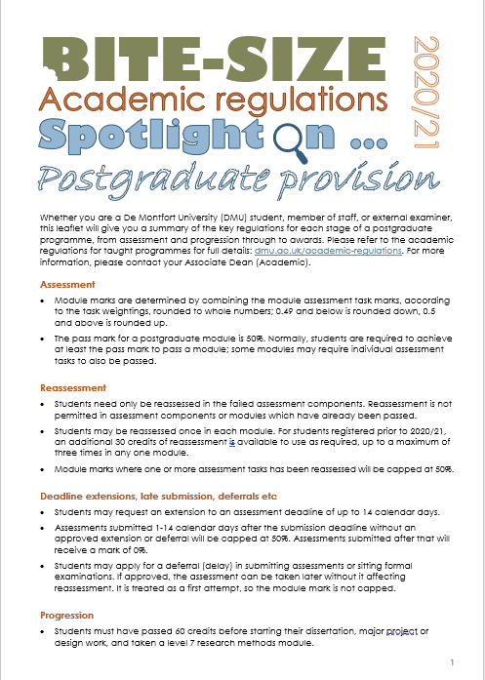
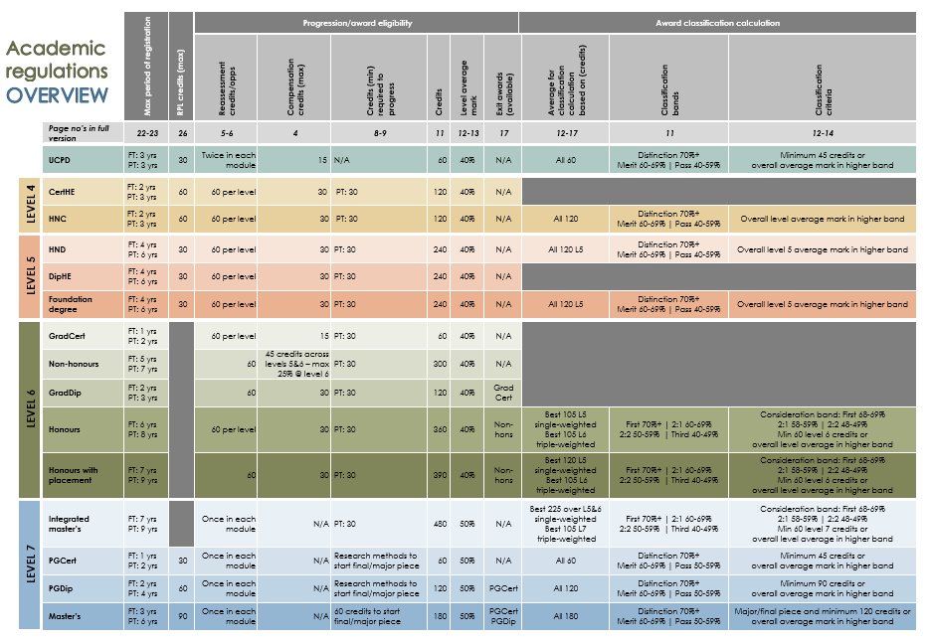
Academic regulations
Full regs includes new appendix on coursework extension deadlines
New leaflets focusing on key regs for UG and PGT
Updated streamlined overview matrix
Programme-specific regulations
Deviations from generic academic regulations
Meet PSRB requirements
Notes:
Covering generic university-wide scheme
Some programmes have regulations which sit outside of generic scheme – held separately
Scheme/regulations jointly managed by DAQ and faculties/ADAs via Taught Programmes Management Committee (TPMC)
Keep regulations under review against sector norms by: - reviewing results of national credit surveys - membership of NUCCAT – northern credit consortium. Other one is SEEC (southern)
- sector surveys on specific topics (via NUCCAT or Academic Registrars’ Council – ARC)
- reading/reviewing other institutions’ regulations - considering and responding to staff and external examiner feedback

Slide 13
Credit Framework and levels
Nationally recognised credit tariff: 1 credit = 10 notional student learning hours
Modules based around 15 and 30 credits, and larger modules. UG dissertation modules normally 30 credits, PGT dissertation modules normally 60 credits
Levels conform to FHEQ: level 4 = primarily diagnostic/formative. Levels 5 & 6 = count towards degree classification. Level 7 = postgraduate
Notes:
Credit framework and levels
DMU conforms to Higher Education Credit Framework for England and the Framework for Higher Education Qualifications in England, Wales and Northern Ireland
Scheme based around 15 and 30 credit modules, with UG dissertations normally 30 credits and PGT dissertations 60 credits

Slide 14
Programme specification
Programme specification to define curricula
Two levels defining programme and module
Module specifications use learning outcomes methodology and link this to assessment
Programme specifications place subject in national context, including subject benchmarks, and define student outcomes
Notes:
Common format to capture module and programme information – specifications – the formal record
Programme specifications include: award; ;exit awards; mode of delivery; entry requirements; characteristics; PSRB accreditation; learning outcomes and module structure
Module specifications include: title; credit value; credit level; outline content and learning outcomes linked to assessment
Faculty will provide you with relevant specifications to support you in your role
If you haven’t received these, talk to the faculty this afternoon.

Slide 15
Awards, credits and maximum periods of registration
 | Levels |  |  |  | Total | Max period reg
 | 4 | 5 | 6 | 7 |  | FT | PT
Master’s degree | - | - | - | 180 | 180 | 3 years | 6 years
Postgraduate diploma | - | - | - | 120 | 120 | 2 years | 4 years
Postgraduate certificate | - | - | - | 60 | 60 | 1 year | 2 years
Integrated master’s | 120 | 120 | 120 | 120 | 480 | 7 years | 9 years
Honours degree with sandwich placement | 120 | 150 | 120 | - | 390 | 7 years | 9 years
Honours degree | 120 | 120 | 120 | - | 360 | 6 years | 8 years
Non-honours (ordinary degree) | 120 | 120 | 60 | - | 300 | 5 years | 7 years
FD / HND / DipHE | 120 | 120 | - | - | 240 | 4 years | 6 years
HNC / CertHE | 120 | - | - | - | 120 | 2 years | 3 years
Notes:
Awards and credits
Table of credits for DMU awards.
UCPD = University Certificate of Professional Development – not on table. DMU-devised CPD award, can be at level 4, level 5 or level 6 as required. Can be used as ‘building blocks’ towards a foundation degree, and has its own section in undergraduate regulations.
Maximum periods of registration
For programmes with sandwich placements, add one year onto maximum period of registration
Maximum period of registration includes any periods of interruption of studies, for example if a student takes a year out due to ill-health.
Varies across the sector – some don’t have them. It helps to focus the student on the end goal and keeps students motivated.
If a student reaches the end of the maximum period of registration for their programme without gaining their intended award, an exit award may be awarded, if possible, on the basis of credits accrued.
UCPD – full time 3 years, part time 3 years.

Slide 16

Key regulations overview
 | Undergraduate |  | Postgraduate
Module pass mark | 40% | Up to 30 credits of compensation | 50% | All modules must be passed to gain award
Compensation | Module pass mark 30-39% | Failures 29% and below must be retrieved | N/A | N/A
Reassessment | 60 credits per level | Module marks capped at pass mark | Once in each module* | Module marks capped at pass mark
* NB additional 30 credits available for students enrolled prior to 2020/21
Compensation rules
Undergraduate only
Module mark 30-39%
Max 30 credits per level
Minimum level average of 40%
Compensation exemptions
Not available for ‘must pass’ modules or essential components
Some programme-specific regulations prevent compensation
Notes:
Module pass mark – use show of hands to gauge varying practice for PGT pass marks
Reassessment -UG
Scheme tries to offer flexibility to meet a variety of needs in terms of reassessment, for example a student may be reassessed more than once in a module if they have reassessment opportunities still available
If a student has failure below 30% it must be retrieved for student to progress and ultimately gain their award
If a student has failure between 30-39% compensation may be awarded (criteria on next slide)
Students may be reassessed in a module where they have achieved 30-39%, to achieve a pass mark (reassessed modules capped at 40%), but only if they have no failures below 30%. Students may choose to do this so that a pass mark is shown on their transcript/Higher Education Achievement Report
Reassessment - PGT
Must ultimately pass all modules to gain award, so reassessment allocation is more generous than UG
Compensation
Compensated against overall performance of achieving 90 credits of passes and attempting the final assessment in the module being compensated – students must show evidence of a genuine attempt at the module.
Not available for must pass modules.

Slide 17
Undergraduate progression
Students’ profile at the end of the academic year after reassessments (typically September)
Per level | Generic regs | Exceptional discretional regs (after reassessments) | Repeat level 4
Passed | 90 credits | 75 credits | 60 credits (30 at first attempt)
Compensatable (30-39%) | 30 credits | 45 credits | N/A
Failed (0-29%) | 0 credits | 0 credits | 60 credits
To note |  | Board’s discretion Demonstrate sufficient competence Only waived for individual students, not cohorts Cannot progress to level 6 carrying level 4 failure | Studies terminated with option to repeat level 4 Reregistration not automatic Previous marks disregarded Not available on some programmes
Notes:
Progression UG
Progression rules – simple and consistent across levels – easy for students to understand.
Apply to all awards which have progression between levels of study
Part-time students – can take L4 and L5 modules within same academic year, or L5 and L6

Slide 18
Postgraduate progression
End of first semester (60 credits of taught modules – not a progression point)
Students who do not pass any modules on first attempt can continue on to the second semester carrying these fails and/or defers.
End of second semester (120 credits of taught modules – progression point)
Before starting the dissertation, major project or design work, students must have passed 60 credits of the taught modules.
Students in this position must take a break in learning to complete the resits and/or defers to achieve the 60 credits required
The principle behind this regulation is one of preparedness, noting the significance of the final piece in the master’s degree classification
Notes:
Progression PG

Slide 19
Award classifications overview
Classification band | Postgrad awards | Integrated Master’s Honours degree | FD/HND/HNC etc
70% and above | Distinction | First class honours | Distinction
60-69% | Merit | Upper second (2:1) | Merit
50-59% | Pass | Lower second (2:2) | Pass
40-49% | Fail | Third class honours | Pass
Below 40% | Fail | Fail | Fail
Notes:
Award
Criteria for award. Key boundaries include: - 40% - pass boundary - 60% - 2:1/merit - 70% - 1st/distinction
Calculation of merit/distinction generally based upon number of credits in higher band and/or overall average of module marks at level of the award
Classification boundaries – use show of hands to gauge varying practice for classification boundaries

Slide 20
Safety-net emergency regulations overview
Continued impact of lockdowns upon student performance
Census date: 11 February 2021 – end of 2020/21 academic session
Applicable to UG and PGT provision – some PSRB accredited programmes excluded
Enhanced extenuating circumstances: extensions, late submission, deferrals etc – no longer in place
Uncapped reassessments – handful of exceptional circumstances
Dual degree classification algorithms – continue until last student graduates
Published info:
https://www.dmu.ac.uk/your-dmu-safety/latest-update.aspx https://www.dmu.ac.uk/documents/ydmus/dmu-emergency-regs-safety-net-11-feb-2021.pdf
Notes:
Best outcome for students while maintaining academic standards and ensuring learning outcomes have been met
Sector-wide approach, supported by Office for Students (OfS) and Quality Assurance Agency (QAA) – HEIs determine own methodology

Slide 21
UG degree classification under safety-net
Award | Normal classification criteria | Safety-net classification criteria
Honours degree Level 5 students* | Best 105 Level 5 single-weighted Best 105 Level 6 triple-weighted | Best 90 Level 5 single-weighted Best 105 Level 6 triple-weighted
Honours degree Level 6 students | Best 105 Level 5 single-weighted Best 105 Level 6 triple-weighted | Best 105 Level 5 single-weighted Best 105 Level 6 double-weighted
Honours degree with placement | Best 120 Level 5 single-weighted Best 105 Level 6 triple-weighted | No change
Integrated master’s Level 5 & 6 students* | Best 225 over Level 5&6 single-weighted Best 105 Level 7 triple-weighted | Best 210 over Level 5&6 single-weighted Best 105 Level 7 triple-weighted
Integrated master’s Level 7 students | Best 225 over Level 5&6 single-weighted Best 105 Level 7 triple-weighted | Best 225 over Level 5&6 single-weighted Best 105 Level 7 double-weighted
* Safety-net criteria applied whenever the final award is made
Notes:
Degree classification
Allows minimal discounting, which allows students to be more daring with their module choices. Discounting is independent of module size. The IT system chunks each level of study into 8 x 15 credit blocks and removes the lowest block
The algorithm places more importance on level 6 as the culmination of study
For integrated master’s programmes a slightly different algorithm applies which takes into account level 5, but still places the greatest importance on the final year of study.
For sub-degree awards it is a simple average taken at the level of the award, e.g. foundation degree = level 5 average

Slide 22


UG degree classification “consideration” band
Band provides a consistent approach to student classification
Rules based: applies if the overall average for classification is not more than 2% below a classification band (ie 48/49, 58/59, 68/69)
Students will be awarded a degree in the higher classification band if the:
Overall percentage across the 120 credits at level 6/7* OR IF:
Module marks in at least half of the level 6/7* are in the higher classification band
* Level 6 if honours degree, level 7 if integrated master’s
15 credits
6
SCEN
SCEN
SCEN
SCEN
SCEN
SCEN
SCEN
SCEN
Level
Avg for
Final classification
3001
3002
3003
3004
3005
3006
3007
3008
avg
mark
class
Student A
55
50
60
62
58
59
63
67
59
58 (2:2)
2:1 
Student B
62
67
70
72
82
77
69
80
72
68 (2:1)
First 
Student C
60
65
67
72
77
68
60
80
69
69 (2:1)
2:1 
Notes:
Consideration band
For honours degrees and integrated master’s programmes only
‘Consideration’ is rules-based, but does provide a fair opportunity to look at borderline student profiles. Not an academic judgement
Two ways to do this, both based on level 6 as culmination of studies – can make up for poorer performance at level 5, reinforcing exit velocity. Emphasises consistency, fairness and transparency.

Slide 23
PG degree classification
Award | Classification criteria
PgCert | Overall average mark in higher band OR minimum 45 credits (out of 60) *
PgDip | Overall average mark in higher band OR minimum 90 credits (out of 120) *
Master’s | Major/final piece AND Overall average mark in higher band OR minimum 120 credits (out of 180)
* Where a PGCert/PGDip is made as an exit award, the best 60/120 credits will be used to classify
15 credits
60 credits
Award aim
SCEN
SCEN
SCEN
SCEN
SCEN
SCEN
SCEN
SCEN
SCEN
Level
7
Final classification
5001
5002
5003
5004
5005
5006
5007
5008
5000
avg
mark
Student A
PGCert
72
52
78
70
-
-
-
-
-
68
Distinction
Student B
PGDip
55
52
60
62
58
59
63
67
-
60
Merit
Student C
Master's
62
67
70
72
82
77
69
80
58
68
Pass
Student D
Master's
60
65
67
72
77
72
60
80
70
69
Distinction
Notes:
Degree classification - PTG
The most importance in the postgraduate degree calculation is the dissertation. A student won’t receive a distinction or merit if the dissertation isn’t in the distinction or merit band. If the dissertation is in the distinction or merit band, there are two further ways of looking at a student’s profile to determine the classification they will achieve

Slide 24
Why we have assessment boards
Accountable for academic integrity of assessment
Verification and ratification of results
Conduct of assessment including determining module marks, progression and awards
Compliance with university and PSRB requirements inc programme-specific regulations
Arrangements and processes for module assessments, moderation and reassessments
Notes:
Assessment boards
Single tier boards
Accountable for academic integrity of assessment
Responsible for the conduct of assessment
Meeting PSRB regulations.
UG boards – Main in June, resit in Sept
PGT boards – March, July, main board in November
Some have other boards during the year to reflect the non-standard delivery pattern

Slide 25
How assessment boards operate
Conducted virtually via MS Teams – student results shared on screen
Mechanistic ratification of student results – fuller discussion at pre-boards
External examiners invited to provide brief verbal report
Reduced constitution for efficiency – academic lead for each programme
Adherence to due process: marking, moderation and external scrutiny
Verbal briefing on the academic regulations under consideration
Notes:
Verbal report from the external examiner
External examiners should be involved with reassessment and invited to the reassessment boards

Slide 26

Key roles for assessment boards
Assoc Dean Academic
Lead academic
External examiner
Stud/Academic Serv
Board operation/ assessment processes
Assessment inc moderation
Confirm marks distribution/raise issues with assessment processes
Regulations applied consistently and fairly
Protocols/quoracy adhered to
Provide accurate/ timely marks
Protocols/quoracy adhered to
Advise on individual cases (internal disagreement)
Regulations applied fairly/ consistently across faculty
Present results at the board
External examiners participated as required
Report on findings/ experience to date
Record changes/ chair’s action
PSRB/programme-specific regulations adhered to
Updates on individual cases

Slide 27
Ratifying student results
Ratify results as presented – late/incorrect marks addressed by chair’s action
No academic discretion permitted (except exceptional UG progression in Sept)
Individual cases not discussed – actions are noted but no details shared
Results considered in student performance order – ranked highest to lowest
Report by exception – clarify borderline cases eg consideration band
Colour and alphabetical coding used to inform student status – key provided
Notes:
Results considered in student performance order – ranked highest to lowest – enables reporting by exception
Individual cases are not discussed – the board is not constituted to consider extension requests, deferrals etc, and APO cases are also dealt with elsewhere therefore discussion about individual students is not appropriate, also to comply with GDPR

Slide 28
Programme
Modules by level
Modules by level
Level
Level
Final outcome
Credit size
Credit size
Code denotes position
Students
Grey = not under consideration
Code denotes position
Ranked by student performance – report by exception

Slide 29
Results ratification – hints and tips
Look out for:
The more colour on the profile, the more issues the student has – focus on these!
Red/peach blocks = module failure – carefully consider students’ position
Check for exit award eligibility before dismissing students
Greyed-out results previously ratified – not under consideration
UG – consideration band – correct outcome?
PG – 60 credit module mark against classification (highest outcome achievable)
ABR code key
A | Award
C | Leaving no award
D | Dismissed
N | Not progressing
P | Progressing
Q | Query
S | Deferred
Z | Progressing exceptionally

Slide 30
External examiner reports
Within one month after the main assessment board
Optional supplementary reports and reports to the PVC or VC
Serious concerns - all internal procedures have been exhausted - QAA independent mechanism for addressing concerns about standards and quality in higher education
Notes:
Louise
When do you report?
One annual report required within a month AFTER the main assessment board. Timely submission is important to enable amendments and monitoring
processes to take place
If you are associated to more than one programme, unless you have been informed otherwise, write one report for all.
Most UG boards in June therefore the reports need to be submitted by end of July. N&M – usually later and have multiple boards but “main” is usually
November as are the PGT boards. Check with programme team.
Interim/supplementary reports may be submitted at any times where an examiner considers that issues have arisen which require prompt attention. This
report is intended to be exceptional and it will not be necessary for examiners to report on the satisfactory operation, or progress of the work, of the assessment board.
An external examiner may send a separate report to the vice-chancellor on any matter which she/he deems necessary; such a report may be sent in confidence
at any time.
Serious concerns about issues related to standards within the institution, and has exhausted all internal procedures including a confidential report to the vice chancellor,
they should access the independent mechanism for addressing concerns about standards and quality in higher education managed by QAA.

Slide 31
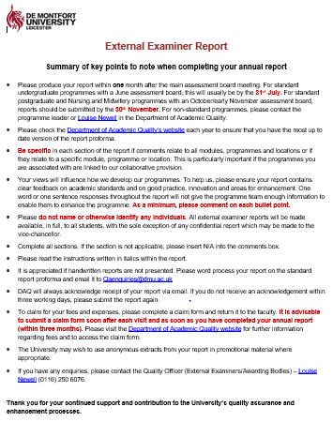
Report proforma
Summary report
Main report
Be specific
What makes a good report?
Evaluative
Submit on time
Volume
Complete all sections
Notes:
Report proforma
Report should be downloaded from DMU website. Don’t expect you to see this
We send links out at various points throughout the session including after this briefing
Report consists of: 1st page - examiners details. Annual/End of Office. Extracts for promotional purposes – not linked to sharing reports with students
2nd page – Quick snap shot summary, tick boxes for the 3 main questions about standard of the programme, standard of the students, fairness of the
assessment processes. Includes free text box for good practice and innovation – on rpt link to what we mean by good practice with some examples. What
we mean by a strength
Areas that require a response from the programme team, school/department, faculty or university. Brief – bullet points. Don’t have to regurgitate
sections from main report.
Main report with free text boxes. Headings are standard.
Bullet point guidance there to help you
Reports shared with students via VLE. Do not refer to staff or students by name.
WHAT MAKES A GOOD REPORT
Submit on time – within a month of main board
Be specific about which programme or collaborative partner you are referring to. Particularly important if you are associated to multiple
programmes and/or at multiple locations
Complete all sections. Some may not be application – add N/A
Balance – clear, informative and evaluative. What worked well, what didn’t. Not descriptive
Volume of text – a lot of brief submissions eg. Acad standards & mod content is appropriate, student performance is comparable. Does the job but not
particularly useful for the team.
Also received reports over 20 pages long which included screenshots and referencing.
As a minimum, cover ALL bullet points
Include verbal report comments made at the board

Slide 32
What happens to your report?
Submit report to qaenquiries@ dmu.ac.uk - 1 month after main assessment board
Report circulated to faculty/ partners
Considered by relevant programme management board
Detailed response sent within 2 weeks after programme management board
Notes:
What happens to your report?
After the report has been received, I circulate it to a number of individuals including PVC Academic, PVC/Dean, APQ, ADA,
HoSch, programme leader, DSU etc ect.
Programme team may take action
Discussed at next programme management board which could be a while after the report has been submitted. HLS ex ex
will receive an additional response from PVC/Dean within 28 days of receipt of the report
Board Chair or PL will send detailed response within 2 weeks of the PMB to inform the examiner of the action taken/not taken.

Slide 33
Monitoring
Monitoring of Faculty Issues:
Associate Professor Quality (APQ) tracks faculty themes, comments upon any regulatory or board operation issues
Monitoring of Institutional Issues:
Read by DAQ and institutional themes highlighted. Appropriate person will respond on behalf of university
Annual overview report submitted to Academic Quality Committee (AQC)
Faculty Programme Self-Assessment Report (PSAR)
Notes:
Monitoring
Monitoring occurs at all levels. Programme team will be address things raised in your report.
Fac level –APQ tracks faculty themes and Faculty Programme Self-Assessment Report (PSAR)
Institutional level – I highlight any issues that need to be addressed on behalf of the University. Usually queries/issues with the regulations or
university policy.
These are then discussed at the Taught Programmes Management Committee (TPMC) and a formal response sent from the Chair.
Also from an institutional point of view, I write an overview report. Based on FPSARs and other info. You will be sent the executive summary
for information in the summer term. Approved at our Academic Quality Committee

Slide 34
Payment of fees and expenses
Annual fee – paid on receipt of annual report and claim form
Visit fee – paid on receipt of claim form. Claim after each “visit”
Expenses – need to provide receipts
Dissertation fee for PGT – keep track of how many dissertations have been reviewed
Notes:
Payment of fees - What
£450 annual fee. FULL FEE. Some examiners may be on something slightly different according to the programme or modules they are
associated with
£90 visit fee including today – virtual visit. You are entitled to claim for a virtual visit fee for a cluster of activities. This
should be for a group of activities that you would have ordinarily attended the University for on that day eg if you attend
an assessment board, the visit fee would also include any meetings with students, the programme team and other external
examiners. Or if you attended one of our virtual external examiners briefing sessions, the visit fee would also include any introductory
meetings with the programme leader, team and administrators. The visit fee is not per meeting.
Eg Assessment board visit includes meetings with students, programmes team and other ex ex. Or, visit for this briefing also
includes other introductory meetings with PL, team, admin.
Dissertation fee for PGT - £12 up to £180
Mileage – 45p per mile
Complete form after each visit, don’t wait until the end of the year. Submit claim form within 3 MONTHS of visit or report submission
If you have to claim for any expenses, make sure you attach/send the receipts. Show form
Important to note: Home address is required.
Purpose of their visit along with dates (eg assessment board, to meet students, to view work)
Programme title (not just the programme code)
Tick appropriate box for what you are claiming for
If completed in hard copy, a signature on the second page.
If examiners are claiming for a fee only and have not made any visits to the university or partners, not applicable should be added in this box.
Missing information on the form may result in a delay in payment.
Keep a copy for yourself.
Fillable PDF form – submit everything electronically. Not sure who is on campus and who is not.
Different for Consultants.

Slide 35
Fees and expenses - when
Submitted by the end of the month
Forms received after this date will be paid the following month
Access payslips via DMUhub using your single sign-on (Blackboard) username and password
Notes:
When
Fees are paid on the 25th of each month or the nearest working day so forms need to be sent by the end of the previous month
for them to be processed in time.
If the cut-off date is missed, the payment will go through the following month. Note – claim form says it needs to be submitted by
9th of each month – this is the date for it to be in with Payroll – needs to be authorised within the Faculty before then so submission at
the of the month.
Payslips on DMUhub. Access it via the staff portal using single sign on username and password which is your BB sign on.
A copy of how to access this has been included in your pack. For DMUhub, account is frozen after 30 days. Need to contact our
IT team to get it reactivated. Can take up to 3 days.
We would have sent you your username and guides at start of appointment

Slide 36
Fees and expenses - who and where to
Arts, Design and Humanities - Arts, Design and Architecture: adhadmin-ada@dmu.ac.uk, Fashion & Textiles: adhadmin-ft@dmu.ac.uk, Humanities & Performing Arts: adh-admin.hpa@dmu.ac.uk, Postgraduate: adh-pgtadmin@dmu.ac.uk
Business and Law - Nicola Warrington: nwarrington@dmu.ac.uk
Computing, Engineering and Media - CSI Kathryn Harris: kharris@dmu.ac.uk, ESD Marisa Haynes: mhaynes@dmu.ac.uk, LMS Chris Voss: chris.voss@dmu.ac.uk, TNE Clark Summers: (csummers@dmu.ac.uk) TNE
Health and Life Sciences - Sophia Welton: swelton@dmu.ac.uk
Educational Partnerships - Educational Partnerships: ep@dmu.ac.uk
Notes:
Who
List of contacts and DMU address
Administrative arrangements
You will have more dealings with the Fac admin as they will make arrangements for your visits. Hopefully they should have introduced
themselves to you. Fac admin are VITAL – make sure you know who your main contact is.
With me, as I have already said, I will be receiving all of your examiner reports – so once a year. Also send out newsletter twice a year.
Also RTW checks – drop me an email if we haven’t verified your docs – I can arrange a Teams meeting.

Slide 37




What happens next?
Emailed copy of:
Presentation
Website links
Useful docs
Faculty will send:
Programme & module specifications
Other programme information
Timeline
Communication
Meeting with programme leader and team
Email from administrator
How did we do?
Complete feedback survey
Notes:
Email from Gita – copy of presentation and all useful docs
Email the PL to let them know that you have attended and if they haven’t contacted you already, we’ll ask them to set up a meeting with you
Email from the admin – introducing themselves
Email including programme/module specifications, timeline of when to expect draft assessments, samples, turnaround times and dates of assessment boards
On the MS Forms – couple of questions about the session. How did we do, what could be better. Spend a minute or two filling that out.

Slide 38
Contacts
Emma Sheffield, Head of Academic Quality esheffield@dmu.ac.uk
Louise Newell, Quality Officer (External Examiners/Awarding Bodies) lnewell@dmu.ac.uk
Suzanne Nelson, Quality Manager (Assessment) snelson@dmu.ac.uk
Notes:
Contacts
Key contacts for your information.
Any questions
Thank you for coming. Hope you found the session useful.
Lastly, have a relaxing Christmas break

Slide 39
Useful resources
DMU website
https://www.dmu.ac.uk
External Examining at DMU
https://www.dmu.ac.uk/external-examining
Academic Regulations and Assessment Boards
https://dmu.ac.uk/assessment-boards-regulations
Assessment and Feedback Policy
https://www.dmu.ac.uk/learning-teaching-assessment
Department of Academic Quality website
https://www.dmu.ac.uk/academic-quality
DMUhub
https://demontfortuniversity.sharepoint.com/sites/DMUHome?wa=wsignin1.0
Advance HE – resources for external examiners
https://www.advance-he.ac.uk/knowledge-hub/external-examining

