Slide 1
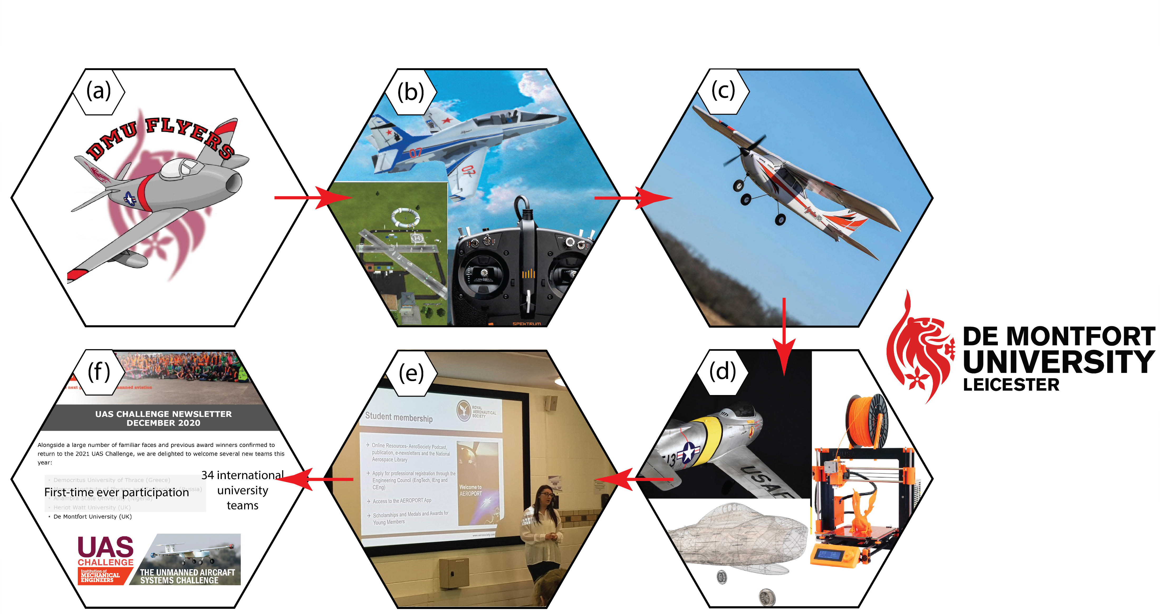

#DMUFlight: Transforming Learning in Aeronautical Engineering Curriculum
K Kandan, Dr F Farukh and Dr H Rajakaruna
Institute of Engineering Sciences, School of Engineering and Sustainable Development

