Slide 1



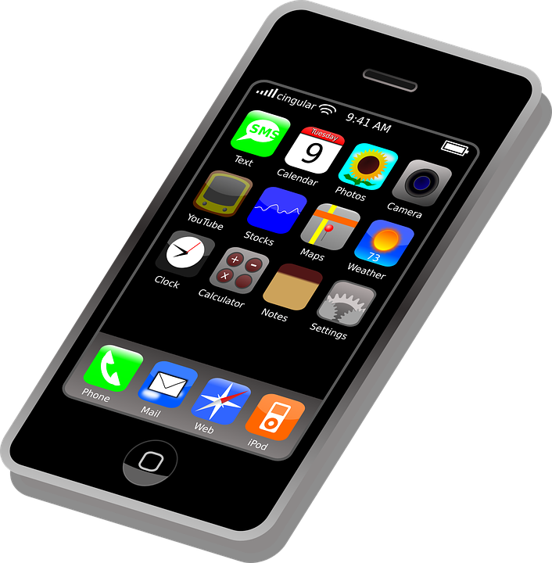

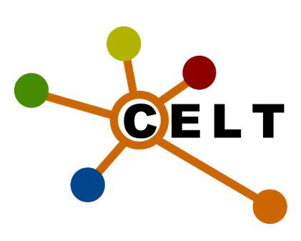

Infographic
DMU Replay – beyond lecture capture
Literature review
Survey
Focus groups
Round table
In the modern era, the most basic function that multimedia platforms are built to perform is lecture capture (Barokas, Ketterl & Brooks, 2010)
Video feedback
Multimedia coursework
e-portfolios
Flipped classroom
Culture change
Confidence
Life skills
Images from Pixabay.com

