Slide 1
Creativity – Making Ideas into Reality
Curiosity enables us to recognise the potential of ideas
Creativity brings the ideas to life
A child’s mind is very curious and creative and we need to nurture this approach to lifelong learning

Slide 2
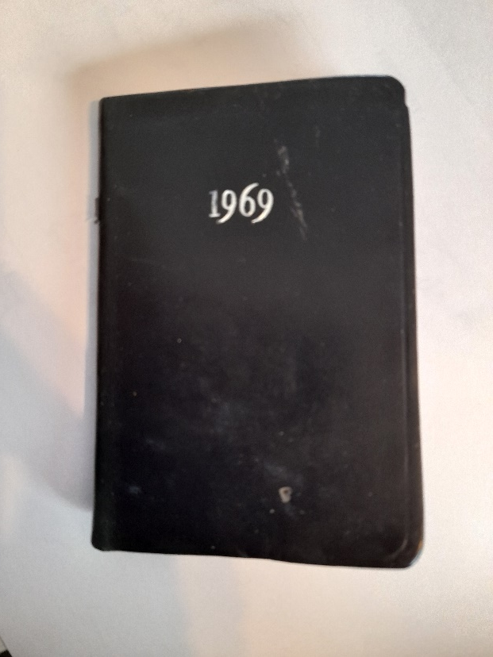
Nurturing Creativity
Being very curious as a child I wanted to put my ideas into reality
But how can we see the world through the eyes of a child?

Slide 3
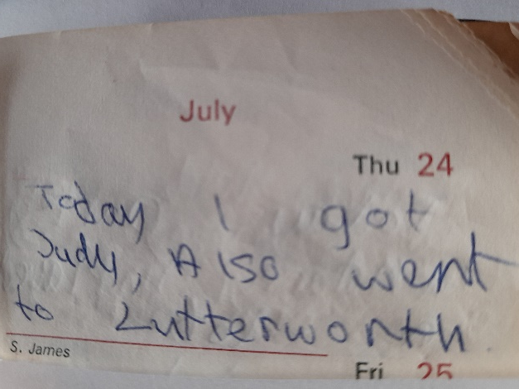
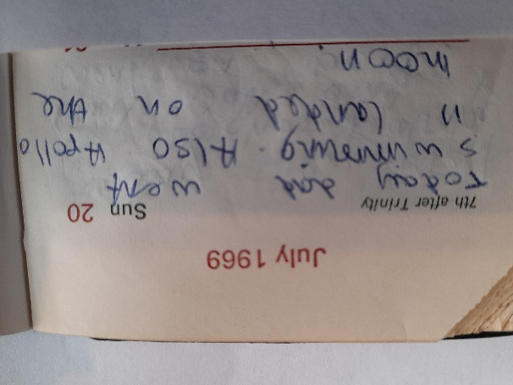
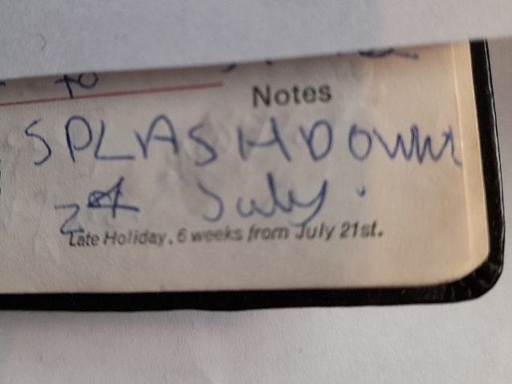
The moon landing – a child’s perspective

Slide 4
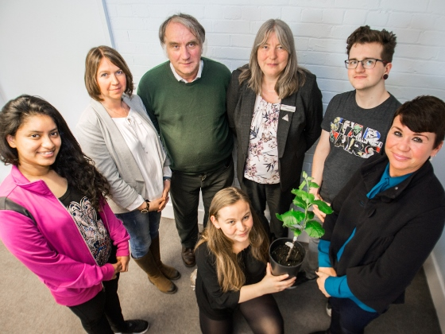
Rekindling Creativity
Museums and University Partnership Initiative – Woolsthorpe Manor

Slide 5
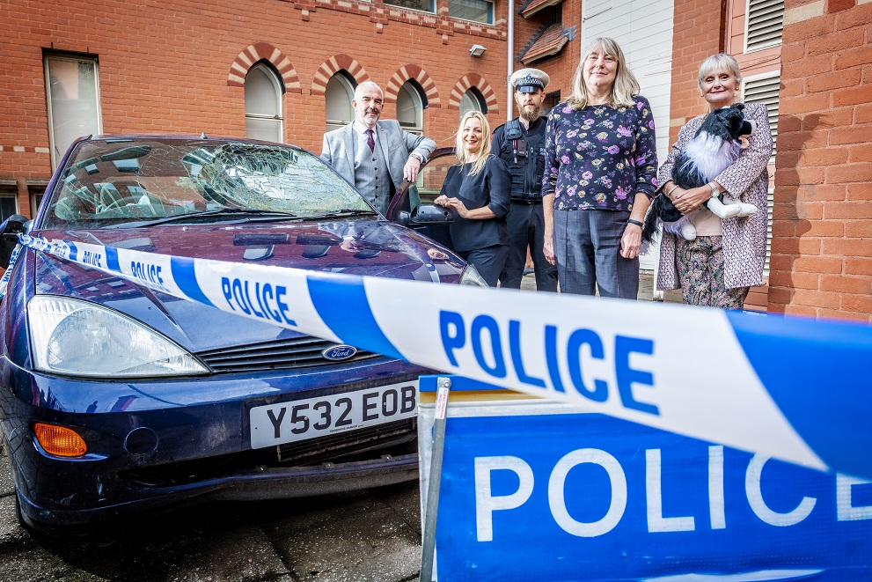
Nurturing Creativity – Disruptive Pedagogy CrashEd

Slide 7
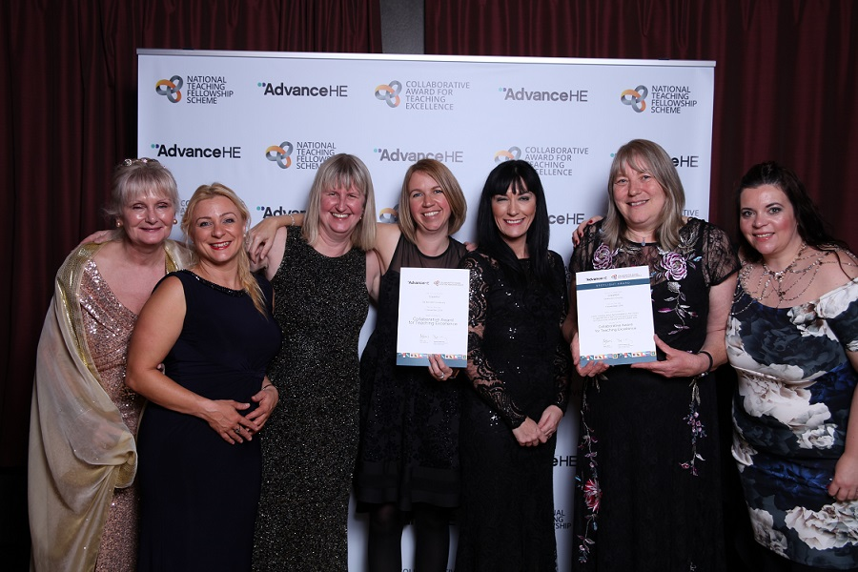
Creativity leads to success – CrashEd Collaborative Award for Teaching Excellence

Slide 8
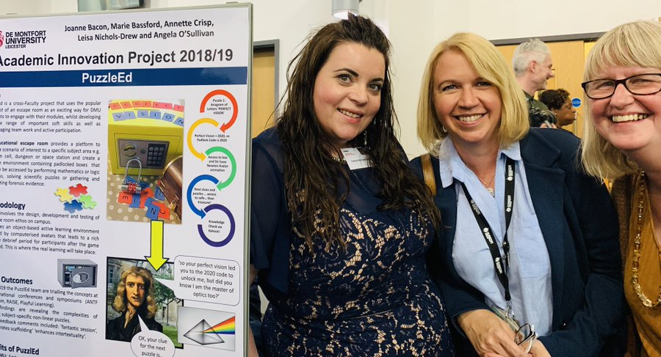
Creativity is contagious – Something positive to pass on
VCDTA / TF / NTF / CATE
Academic Innovation Projects
CAI sabbaticals

