Slide 1
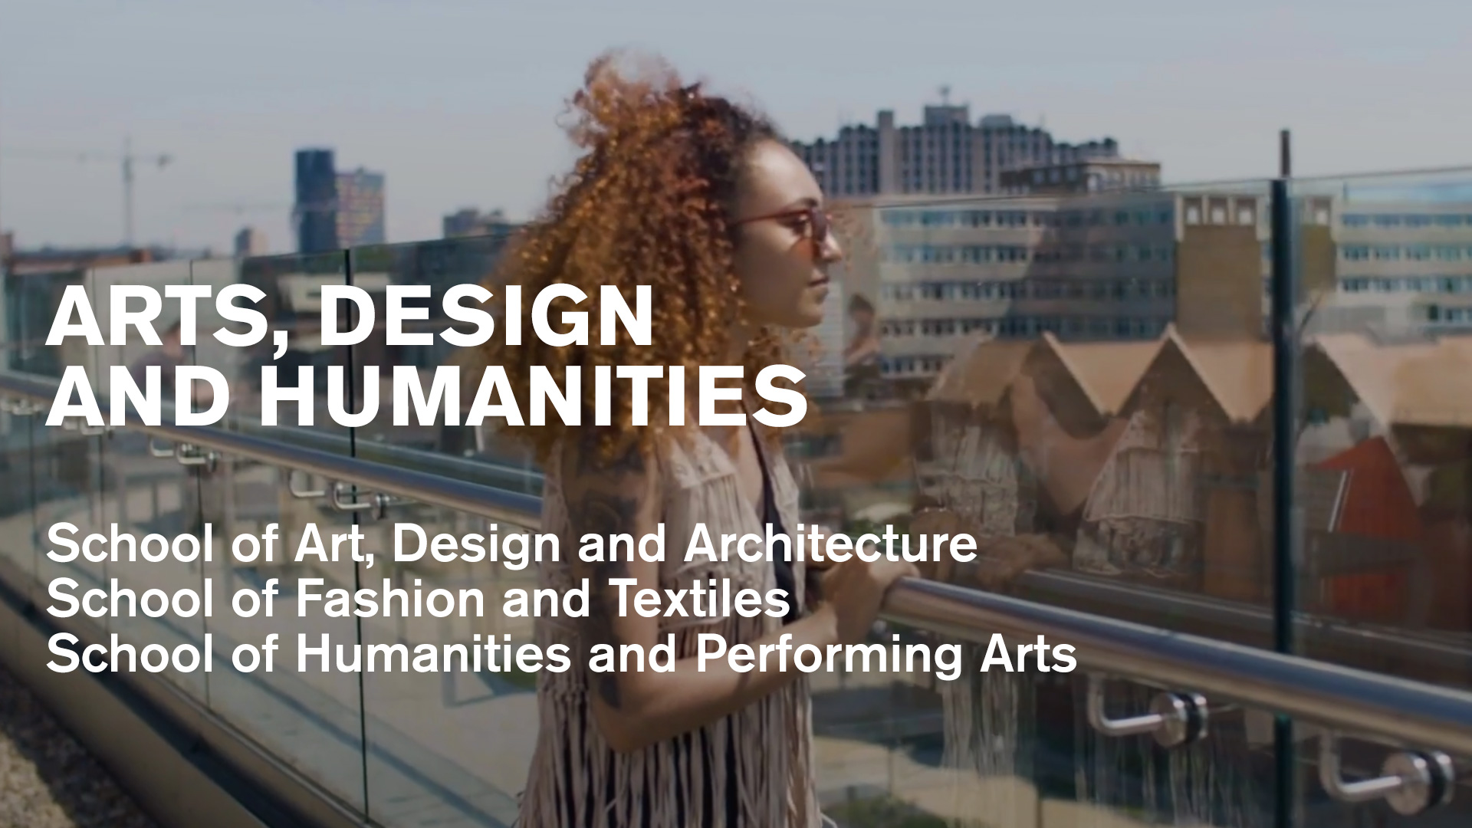
Notes:
FACULTY
The Faculty of Arts, Design and Humanities brings together award-winning students, world-leading research and innovative thinking
We are serious about giving our students the very best experience possible and our ambition is to provide them with all of the tools they need to achieve their aspirations.
All of our students belong to one of our three schools. Each school delivers a wide range of courses as well as overseeing world-changing research and fostering enviable commercial links that inform our teaching and ensure our courses are relevant to modern employers

Slide 2
Arts, Design and Humanities
The Faculty of Arts, Design and Humanities brings together award-winning students, world-leading research and innovative thinking
We are serious about giving our students the very best experience possible and our ambition is to provide them with all of the tools they need to achieve their aspirations
All of our students belong to one of our three schools. Each school delivers a wide range of courses as well as overseeing world-changing research and fostering enviable commercial links that inform our teaching and ensure our courses are relevant to modern employers

Slide 3

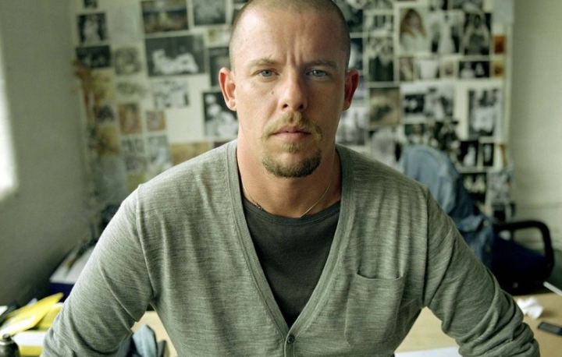
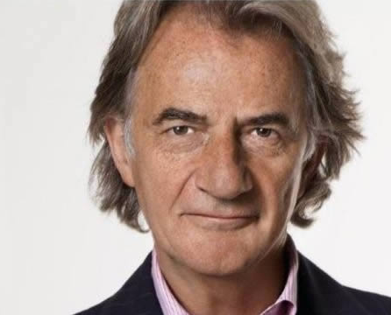

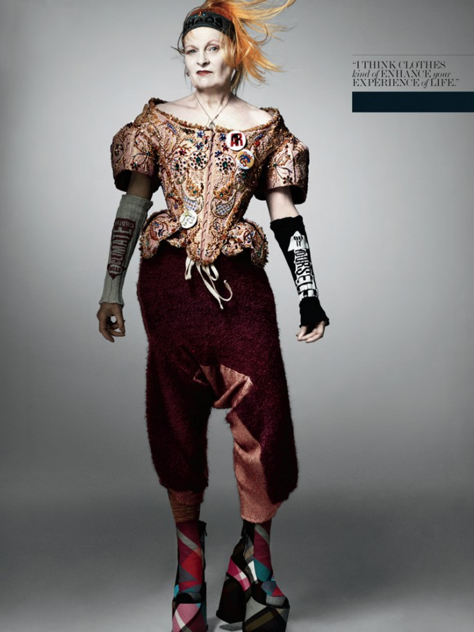

Alexander McQueen
Paul Smith
Orla Kiely
The United Kingdom is renowned worldwide for its creativity.
According to government sources, the UK creative industry is worth around £90 billlion a year, second only to the finance sector.
What is it that makes the creative industry such a power house in the UK - this force of creative thinking.
Vivienne
Westwood
Stella McCartney
Great British Designers
Paul Smith
Notes:
The United Kingdom is renowned worldwide for its creativity.
According to government sources, the UK creative industry is worth around £90 billlion a year, second only to the finance sector.
What is it that makes the creative industry such a power house in the UK - this force of creative thinking.
Within every major fashion house and/or brand, you will find at least one British designer.

Slide 4
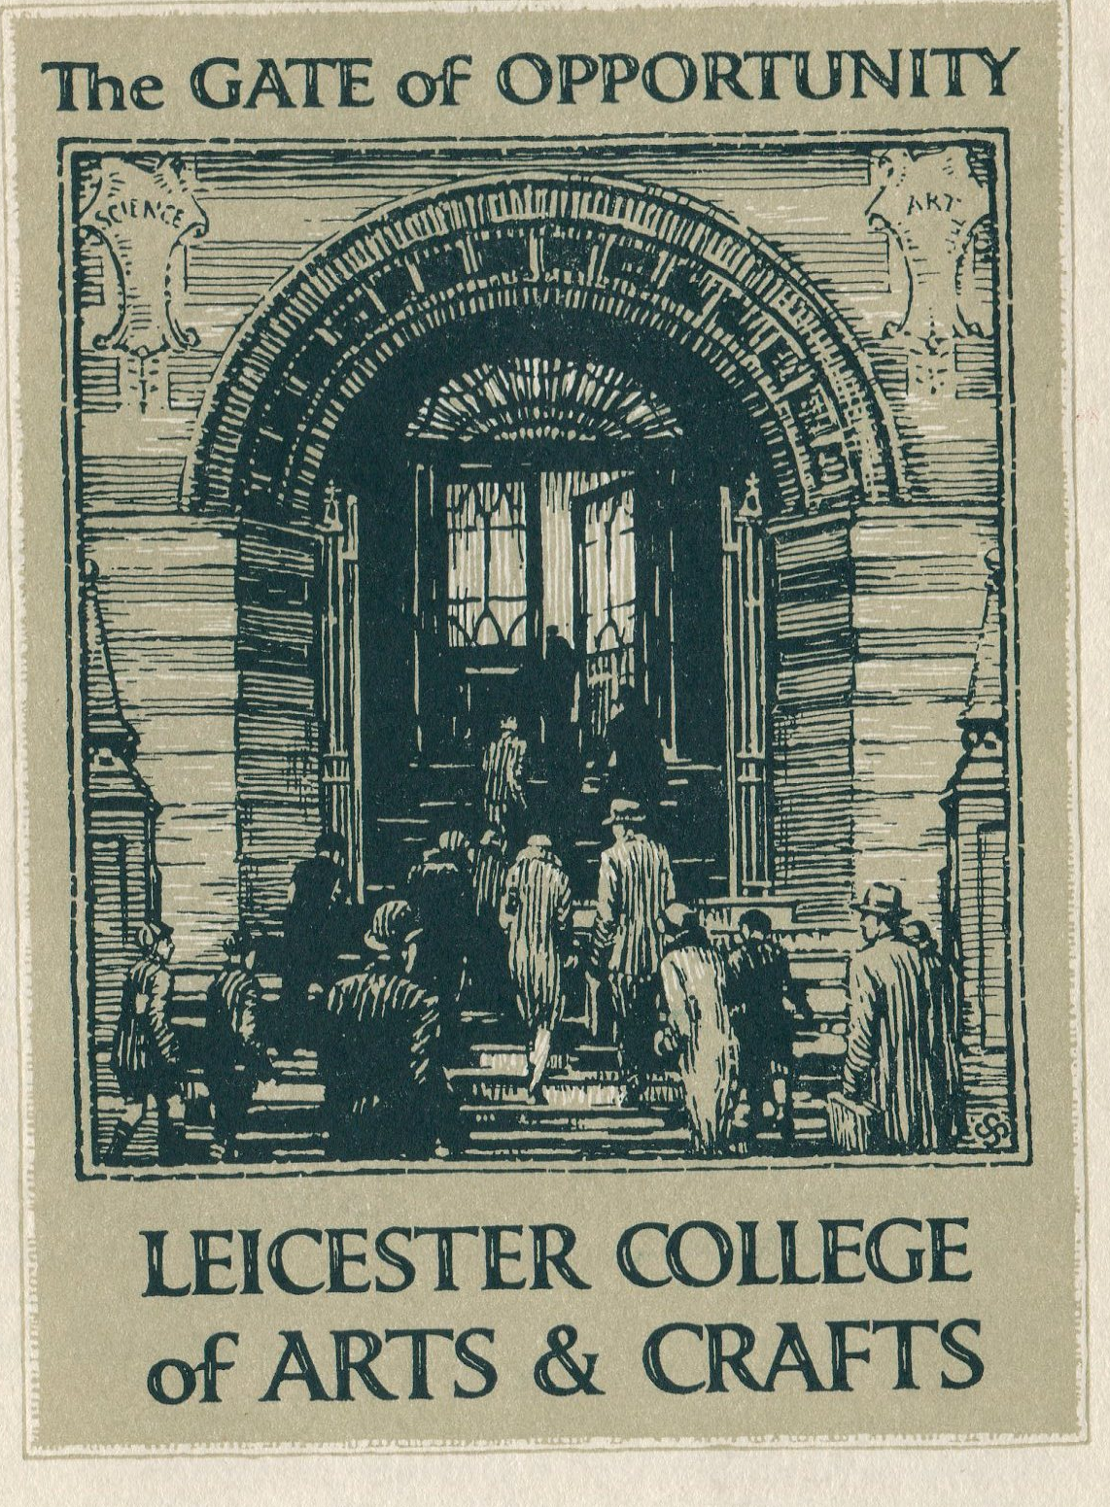
Heritage
DMU has a great heritage of Fashion and Textiles being based in Leicester one of the key global centers of hosiery, corsetry and footwear manufacture in the early 20th century. DMU’s origins are as the Leicester School of Arts and Crafts founded in 1870. An enterprising institution form the start – with evening classes and education for all offered with the marketeers of the day naming this the Gate of Opportunity!
Each town had an Art school teaching design and technical skills linked to the industry of that town
Leicester – Fashion, Textiles, Footwear, Corsetry, Art
Contour at DMU was established in 1947 via Fred Burley, founder of brand label, Berlei and President of the Corset Guild of Great Britain, who recognised the necessity for a course which would meet the growing demand for trained lingerie designers for the local corset industry.
Footwear at DMU is based on over 120 years of footwear education, of which 60 years are at degree level.
We are proud to continue that heritage today.

Slide 5

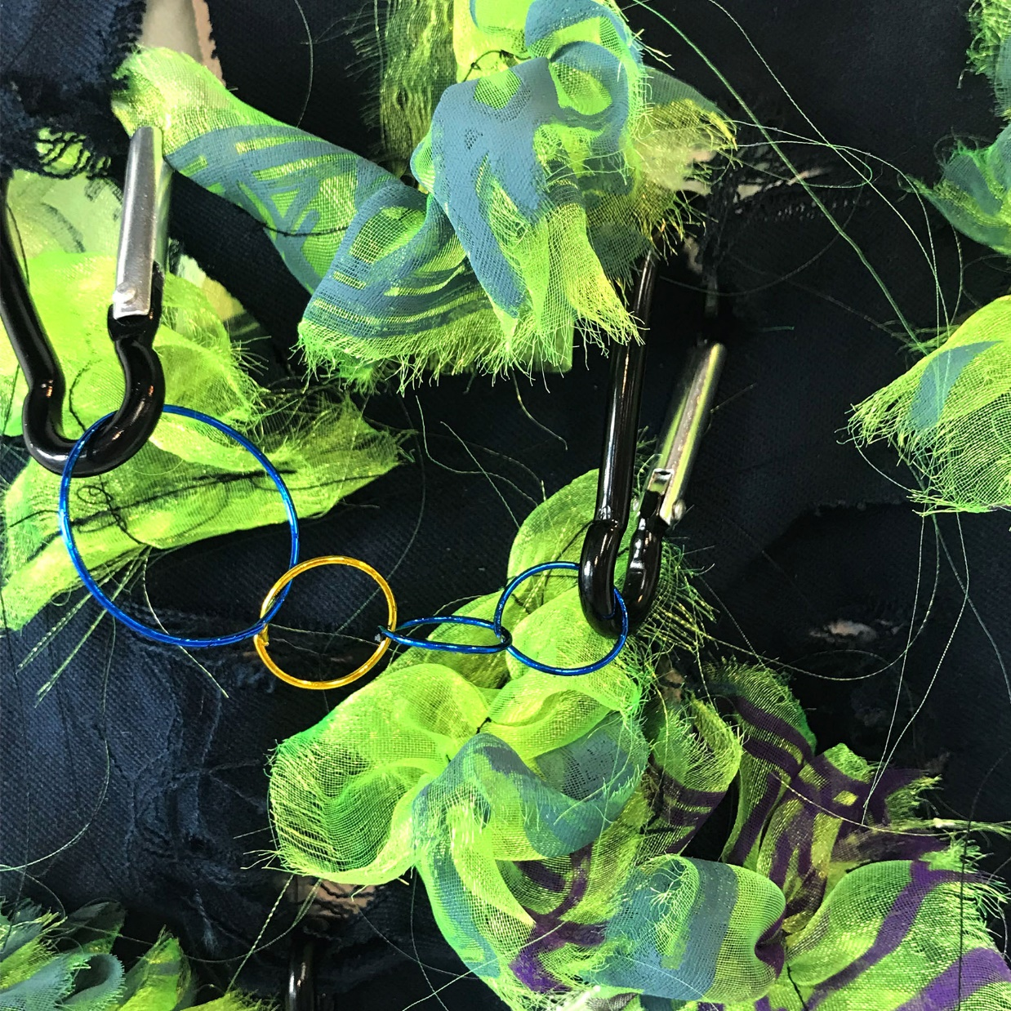
Why DMU?
Programme choice
Focus on sustainability
Excellent industry links
Showcasing opportunities
Excellent employability
Postgraduate study and research
Notes:
Working alongside industry, via ‘live’ projects and competitions, students have an unequivocal opportunity to generate innovative design concepts, styling and embrace new technologies.
Today’s graduates are conceptual designers, architects, structural engineers, technicians, CAD creatures and innovators.
Despite the current economic climate, graduates are still being sought after in the job market.
This is an opportunity for many companies who are moving their creative team forward with new vision.
We are confident that our graduates will continue to become some of the most sought after and influential designers of the future.

Slide 6
ART AND DEISGN TECHNICAL FACILITIES
34 specialist Technical Instructors all with significant industry experience
25 industry standard workshops available each specialising in a different process or material
Our workshops are split into four zones: Crafts, Fashion and Textiles, Design and Arts

Slide 7
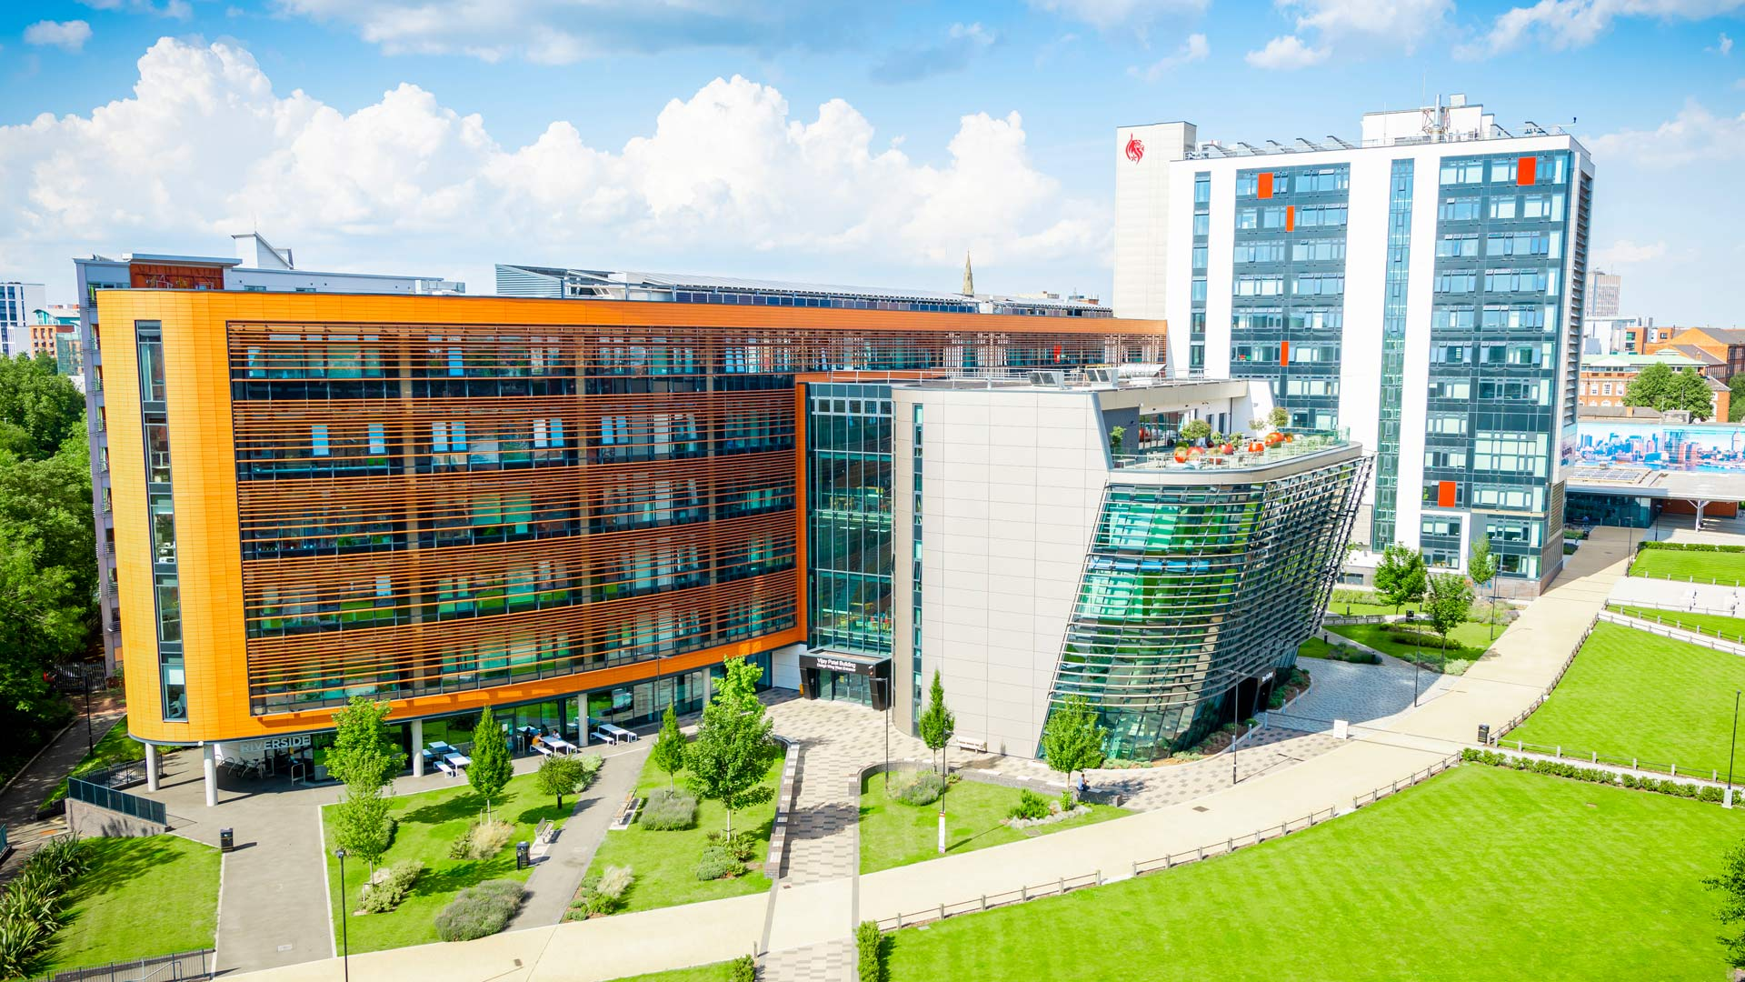
VIJAY PATEL BULIDING
Drawing together the full spectrum of art and design, from traditional processes to cutting-edge innovation, we offer an unrivalled environment for our students to be creative, experiment and innovate
Our award-winning Vijay Patel Building, brings all of our art and design courses together offering inspiring, flexible spaces, studios and facilities which invite creativity
Our state-of-the-art workshops, labs and studios enable our students to experiment and test in the same way they will in industry, while the open and transparent spaces in the building encourage collaboration between disciplines
In doing so, this building supports students to be both ready for industry and future leaders in their respective fields.

Slide 8
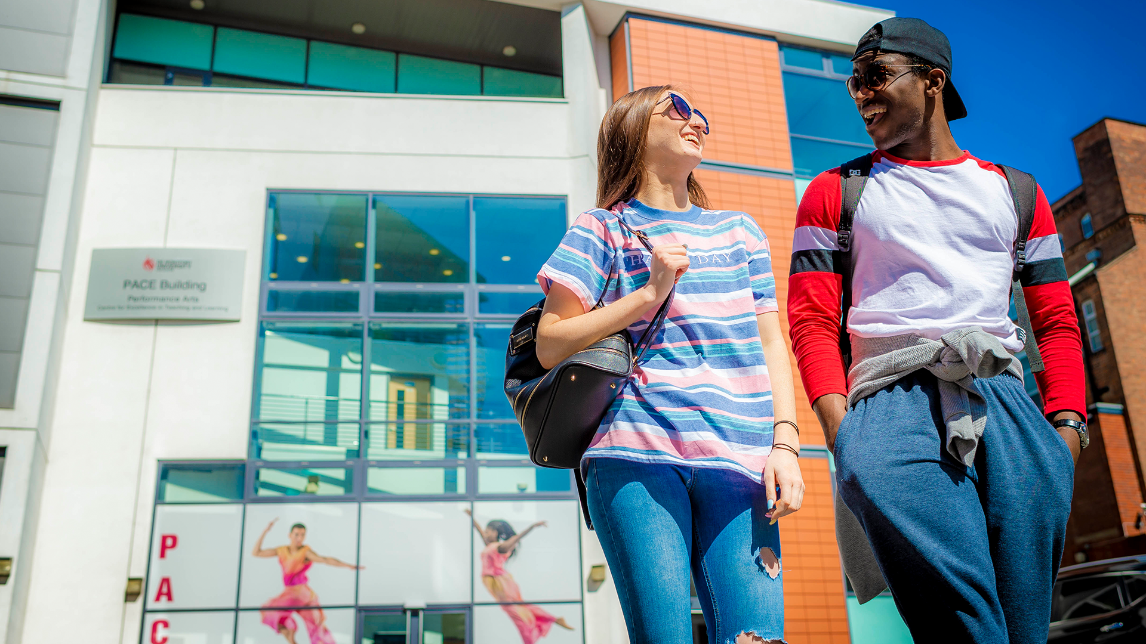
PACE BUILDING
We are proud to say DMU is recognised as a Centre for Excellence in Performance Arts by the Higher Education Funding Council of England
We offer some of the finest facilities in the sector to support your studies.
The Performance Arts Centre for Excellence (PACE), and the Campus Centre building include spacious studios and rehearsal rooms as well as large, fully equipped performance spaces. Your creative work is supported by expert technicians and you are able to book rehearsal space and equipment such as digital video cameras, sound recording equipment and editing suites – outside of your taught time:
Our studios are the perfect environment to bring your creativity to life and work collaboratively with others. We have fully equipped studio theatre spaces and a multi-disciplinary performance space that is often used to support live-digital work. Our dance studios are located on the top floor of the PACE building with sprung floors, mirrors and barres.
All of our spaces can be transformed to turn your ideas into a reality. Your creative work is supported by expert technicians and you can book rehearsal space and equipment such as digital video cameras, sound recording equipment and editing suites.
Notes:
PACE BUILDING
We are proud to say DMU is recognised as a Centre for Excellence in Performance Arts by the Higher Education Funding Council of England
We offer some of the finest facilities in the sector to support your studies.
The Performance Arts Centre for Excellence (PACE), and the Campus Centre building include spacious studios and rehearsal rooms as well as large, fully equipped performance spaces. Your creative work is supported by expert technicians and you are able to book rehearsal space and equipment such as digital video cameras, sound recording equipment and editing suites – outside of your taught time:
Our studios are the perfect environment to bring your creativity to life and work collaboratively with others. We have fully equipped studio theatre spaces and a multi-disciplinary performance space that is often used to support live-digital work. Our dance studios are located on the top floor of the PACE building with sprung floors, mirrors and barres.
All of our spaces can be transformed to turn your ideas into a reality. Your creative work is supported by expert technicians and you can book rehearsal space and equipment such as digital video cameras, sound recording equipment and editing suites.
Play Performance arts video on next slide >>>> 00.00.57 in length

Slide 9
PERFORMANCE TECHNICAL FACILITIES
20 specialist Instructors all with significant industry experience
8 dedicated studio spaces that include sprung floors, lighting rigs and floor to ceiling mirrors
With AV Loans students can rent out video and audio equipment as well as having access to editing software and suites
Studio spaces are bookable, so students are able to rehearse and refine their practice

Slide 10
















GRADUATE CAREERS

Slide 11
USEFUL LINKS
UG and PG art and design course portfolio advice: /portfolioadvice
UG performance arts course practical workshop advice: /practicalworkshopadvice
Showcase of the art and design facilities in the award-winning Vijay Patel Building: /aad
Showcase of the Festival of Creativity that celebrates the diverse, original and innovative creations of our final-year students: /foc

