Slide 1
Mental health and those who perpetrate Intimate Partner Violence
Neil Blacklock, Respect and Caroline Freeman, Jenkins Centre

Slide 2
Workshop Aims
Increase understanding of how perpetrators of DV may ‘present’ their issues to professionals.
Increase understanding of best practice guidelines for multi-agency interventions to responding to DV.
To highlight the most appropriate interventions for perpetrators of DV.

Slide 3
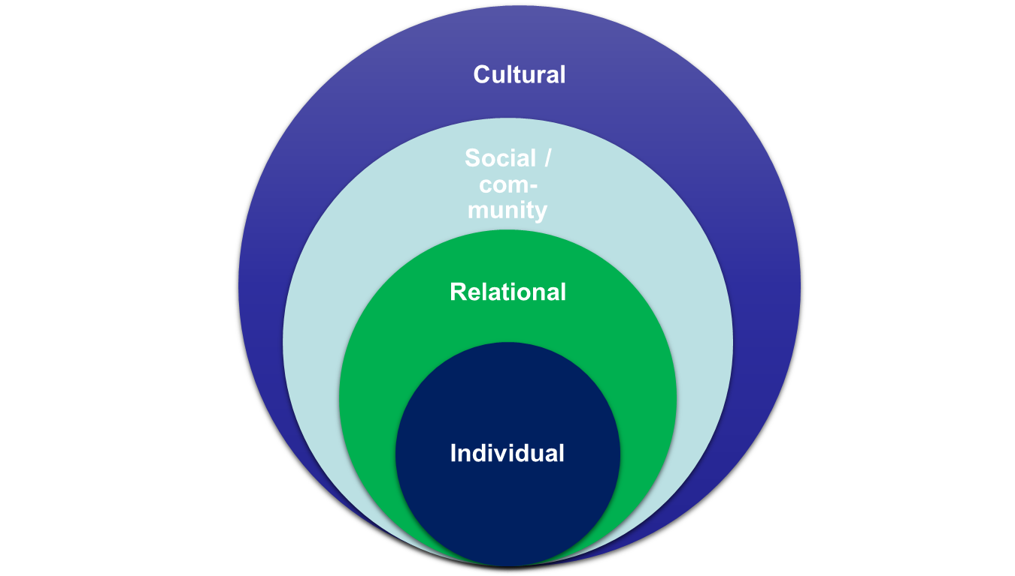
Explanations for IPV perpetration
Ecological model
(Bronfenbrenner, OMS):
Different causes /
explanations
on different levels

Slide 4
Individual Level
Causes / explanations on the individual level:
Psychopathology
Character / Personality / Biology / Genetics (aggressiveness, sadism, lack of impulse control, etc.)
Social Learning Theory (violence works)
Early Trauma
Attachment

Slide 5
Relational Level
Causes / explanations on a relational level:
Consequence of dysfunctional patterns (conflicts, provocation)
Homeostatic function (regulating power, distance, etc.)

Slide 6
Socio-Cultural level
Causes / explanations on a social / community level:
(Institutional) Legitimization of violence
Violent (role) models (media)
Impunity of violence
Causes / explanations on a cultural level:
Violence as a specific form of male domination (patriarchy)
Violence as performance of hegemonic masculinity

Slide 7
Why do they do it?
Rather than asking for causes (why?) we propose to look at the intentions / goals of the violence (what for?)
Usually, violence is used as an intent to maintain or re-establish the control over the partner, the relationship or oneself
Effective Perpetrator Responses
Violence is unacceptable & the abuser is 100% responsible for his abuse
It is a behaviour with an intent
It is a behaviour that is learned
It is a behaviour that is systematic

Slide 8
What we know about mental health and the perpetration of IPV
Almost half the sample (48%) were alcohol dependent. Gillchrist 1999 – not found in community samples but replicated in other offender profiles
Gondolf’s sample of 880 men referred to DV intervention programmes in the US , 60% had tendencies of narcissitic-paranoid continuum sub- clinical – over blown sense of entitlement showing hostile attitudes towards women and inflated sense of self rather than low self esteem
Gondolf – 8% Paranoid disorder, 4% borderline disorder
Gondolf – the men who re assaulted their partners were no more likely to appear with psychopathic disorders than those who did not
Risk factors – previous violence (generalized aggression), alcohol/substance abuse – getting drunk – suicide threats or attempts

Slide 9
How do Perpetrators present to professionals in health and social care settings?
Research by Hester & Westmarland et al ( 2006) in the North-East on Service provision for perpetrators of DV found that from the sample of 64 men, the majority would seek help from their GP’s as a first point of contact.
When perpetrators went to their GP- they would position themselves as ‘Sad’ (depressed) or ‘mad’ ( in need of psychological or psychiatric care) with a focus on ‘poor me ‘ rather than their unacceptable behaviour.
Routine enquiry about the use of violent and abusive behaviour at the point of help seeking can ensure that perpetrators can access the most appropriate intervention, which may include mental health services or more likely a DV perpetrator programme ( if available).

Slide 10
Barriers to Disclosure
WHAT ARE THE BARRIERS TO DISCLOSURE FOR PERPETATORS OF DV?

Slide 11
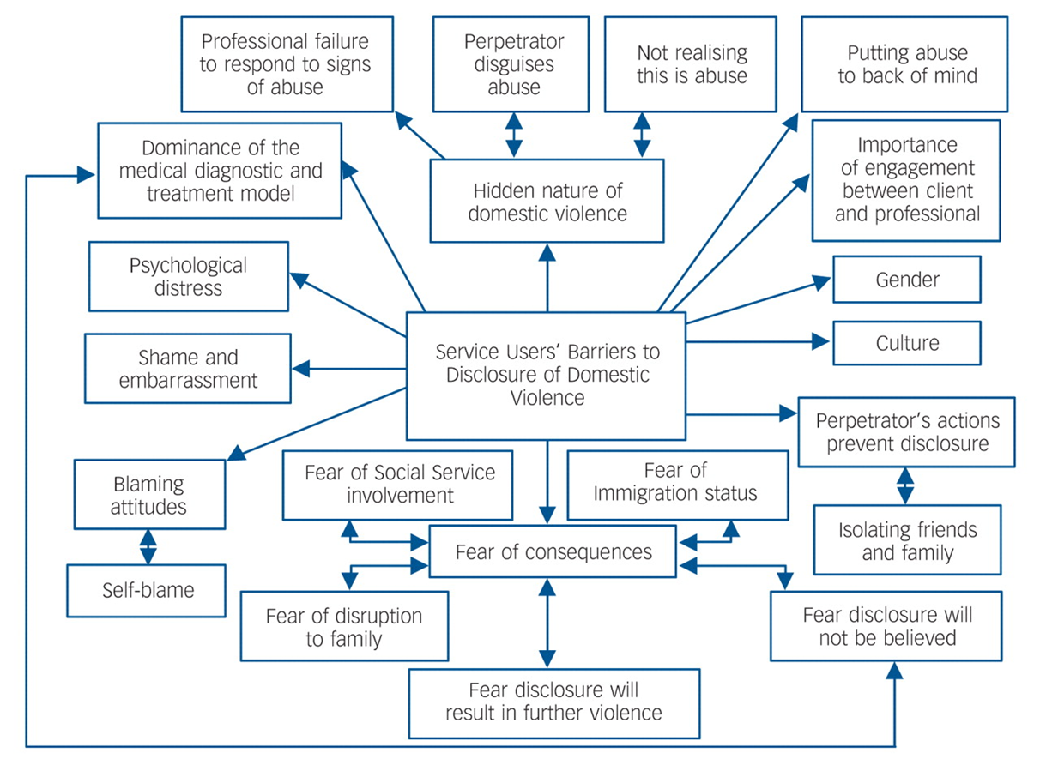
Barriers to disclosure

Slide 12
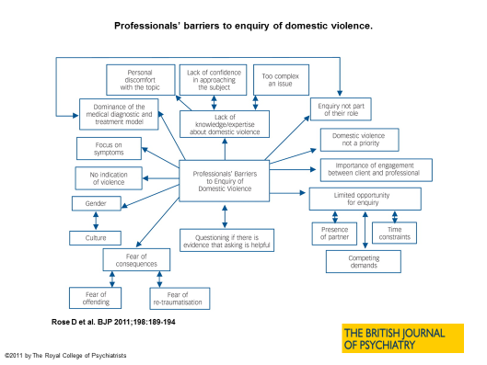

Slide 13
What to do
Symptoms associated with some mental health diagnoses mirror behaviours common to many male perpetrators; this can make it particular difficult for practitioners to understand the motivations for violence and how to respond.
Current psychological interventions alone are unlikely to address the complex dynamics centred on power and control issues which underlie domestic violence committed by the majority of offenders. In some cases they can reinforce ‘poor me’ symptoms common to most perpetrators
How do we know whether someone is in need of a Psychological assessment or something else?

Slide 14
Case studies
What should you be concerned about?
What should you be asking about?
What should your response be?

Slide 15
ASKING THE RIGHT QUESTIONS
If the man presents with “mitigating factors” E.G drinking, stress or depression, these are useful questions to ask:
“How is this drinking/stress at work/depression affecting how you are with your family?”
“When you feel like that what do you do?”
“When you feel like that, how do you behave?”
“Do you find yourself shouting/smashing things…………?”
“Do you ever feel violent towards a particular person?”
“It sounds like you want to make some changes for your benefit and for your partner/children. What choices do you have? What can you do about it? What help would assist you to make these changes?”

Slide 16
ASKING THE RIGHT QUESTIONS
If the man has stated that domestic abuse is an issue, these are useful questions to ask:
“It sounds like your behaviour can be frightening; does your partner say she is frightened of you?”
“How are the children affected?”
“Have the police ever been called to the house because of your behaviour?”
“Are you aware of any patterns – is the abuse getting worse or more frequent?”
"How do you think your bi-polar/depression/anxiety affects your behaviour?"
“What worries you most about your behaviour?”

Slide 17
Asking the Right Questions
If a man responds openly to prompting questions, more direct questions relating to heightened risk factors may be appropriate:
"Do you feel unhappy about your partner seeing friends or family - do you ever try to stop her?"
"Have you assaulted your partner in front of the children?"
"Have you ever assaulted or threatened your partner with a knife or other weapon?"
"Did/has your behaviour changed towards your partner during pregnancy?"
“What has been the worst occasion of violence?”
“Have you ever grabbed your partner by the throat?”
“Do you feel that your behaviour has got worse?”
“How do you feel about your behaviour? What effect has it had on you?”
“What effect has your behaviour had on your partner/children?”

Slide 18
Non-Collusive Responses
Anger management is inappropriate
Implies that the victim provokes the anger and precipitates the abuse
Fails to account for the premeditated controlling behaviours associated with abuse
Often misrepresented as a ‘quick fix’ that may endanger partners
Does not specifically address the social reinforcements for violence against women
( Gondolf & Russell 1986)
Researchers assessed prisoners incarcerated for violent crimes (n=252) with nine psychological tests and reviewed their criminal records. Found that prisoners levels of anger were not associated with their past violence or risk for future violence (Gondolf 2002).

Slide 19
NON- COLLUSIVE RESPONSES.
Couples counselling is inappropriate and can be unsafe
Locates the problem of dv within the family rather than a result of fundamental inequality between men and women
Adds to the belief that victims are somehow to blame for the violence and likely to add to the abuser’s denial or projection of blame
Work is unlikely to be successful when one partner is fearful about how much they can disclose about the relationship. Common for victims to minimise what is happening for fear of consequences and possible retaliation at home
At least 20 US states, most of Australia and New Zealand couples based interventions are prohibited by law.

Slide 20
NICE guidance recommendation 4
Ensure there are integrated care pathways for identifying, referring (either externally or internally) and providing interventions to support people who experience domestic violence and abuse, and to manage those who perpetrate
Ensure all service pathways have consistent, robust mechanisms for assessing the risks facing adults who experience domestic violence and abuse and any children who may be affected. This includes ensuring those affected by, and the perpetrators of, the violence and abuse are kept separate from each other when receiving support

Slide 21
NICE recommendation 5 and 6
Establish a referral pathway to specialist domestic violence and abuse agencies (or the equivalent in a health or social care setting).
Recommendation 6
Ensure staff know, or have access to, information about the services, policies and procedures of all relevant local agencies for people who experience or perpetrate domestic violence and abuse

Slide 22
NICE recommendation 13 and 14
Ensure any treatment programme includes an ongoing assessment of the risk of further domestic violence and abuse, collaborative safety planning and the offer of a referral to specialist domestic violence and abuse support services. It must also take into account the person's preferences and whether the violence and abuse is ongoing or history
Commission tailored interventions for people who perpetrate domestic violence and abuse, in accordance with national standards and based on the local needs assessment.

Slide 23
The Jenkins Centre
24 week , CBT based , behaviour change programme for perpetrators of Domestic violence ( male & female, over 18, can take referrals for LGBT clients and non- English speakers)
Referrals can be made through the DV helpline: 0300 1230918
By email: info@jenkinscentre.org
Calling directly: 0116 2540101

